Slide 1

Javascript Advanced Node.js
Vojtěch Šebek

Slide 2
Motivation
Copyright © 2016 Unicorn Top Gun Academy
Notes:
motivation is important

Slide 3
Agenda
JavaScript
Extended recap
Scopes
Advanced
Closure
Binding
Prototypes
Classes
Node.js
EventLoop
Callback
Promise
Async / Await
Node.js API
Copyright © 2016 Unicorn Top Gun Academy
Notes:
mission includes much more details than JS Basic

Slide 4
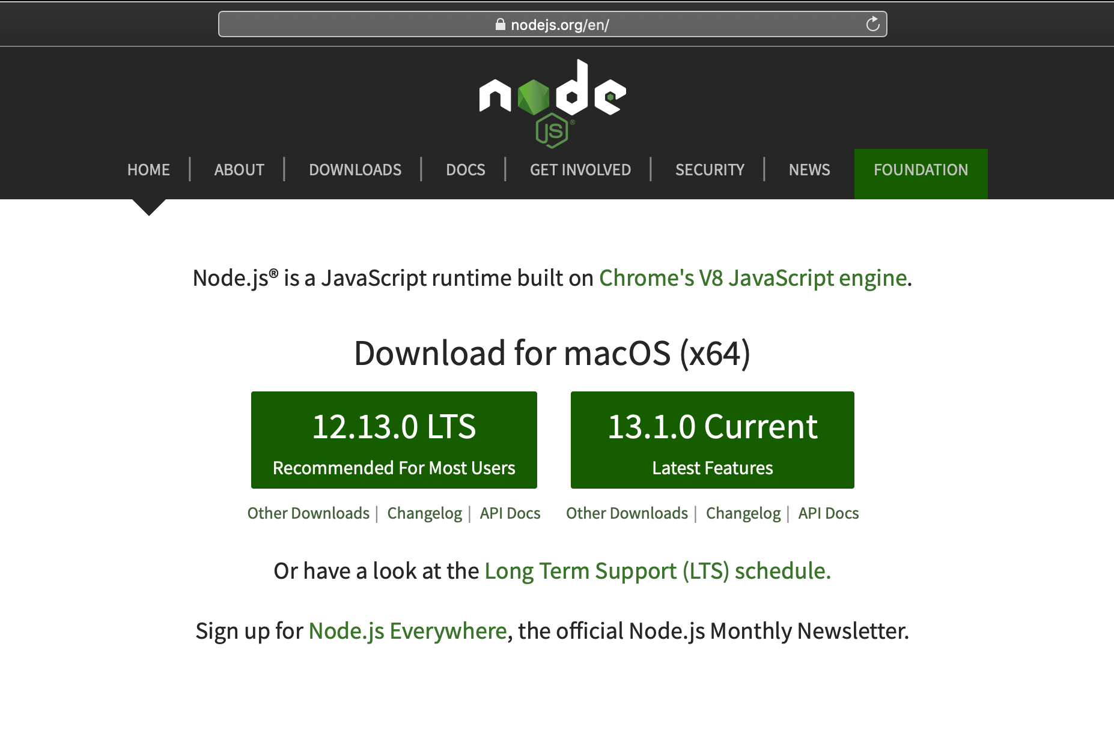
Preparing development environment
Node.js LTS
NPM
IDE - IntelliJ (only full versions) or VSCode
Notes:
- for this mission, they need to install Node.js LTS, LTS = Long Time Support, these versions are then used in production
- current version often includes many bugs and features might be removed and will never be in porduction

Slide 5
VSCode plugins:
recommended for this mission:
terminal
JavaScript (ES6) code snippets
Path Intellisence
npm
npm Intellisence
Eslint
Prettier
jest
Node.js Modules Intellisence
node-readme
Node JSON Autocomplete
gitignore
Jest Snippets
Jest Runner
Jest Test Explorer + Test explorer UI
optional, but it might make your life easier
Material Icon
JS Refactor
IntelliJ IDEA Keybinding
GitLens
Atom one dark Theme
Notes:
Go through recommended plugins for this mission at least
everyone who will use VSCode during this mission or for any following mission should install at least recommended plugins
plugins in the option section are my favourite plugins, makes the IDE look better, helps with refactoring and also allows to use same shortcuts across multiple IDEs
GitLens is IDE alternative to software like Sourcetree, it is really easy to use, for example to compare multiple versions of project, see who did what etc

Slide 6
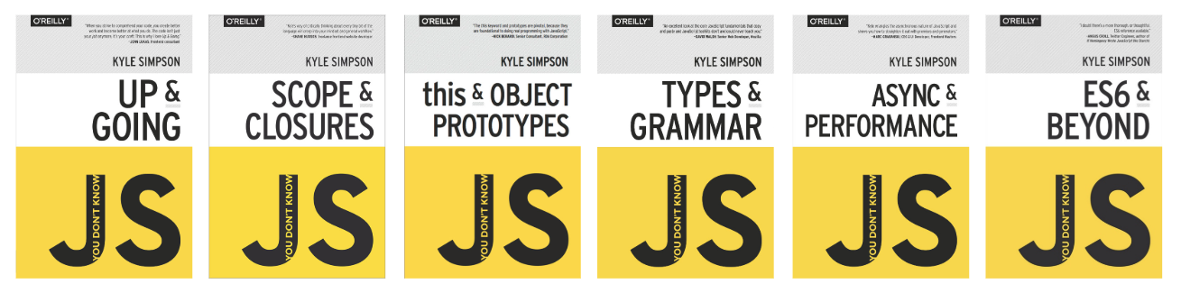
YDKJS
You Don't Know JS
https://github.com/getify/You-Dont-Know-JS/blob/1st-ed/README.md
Read online for free!
Notes:
- This mission is based on these books so if there is someone, who is experienced in JS, these books would be useful for him or as next sequel for him after this mission

Slide 7
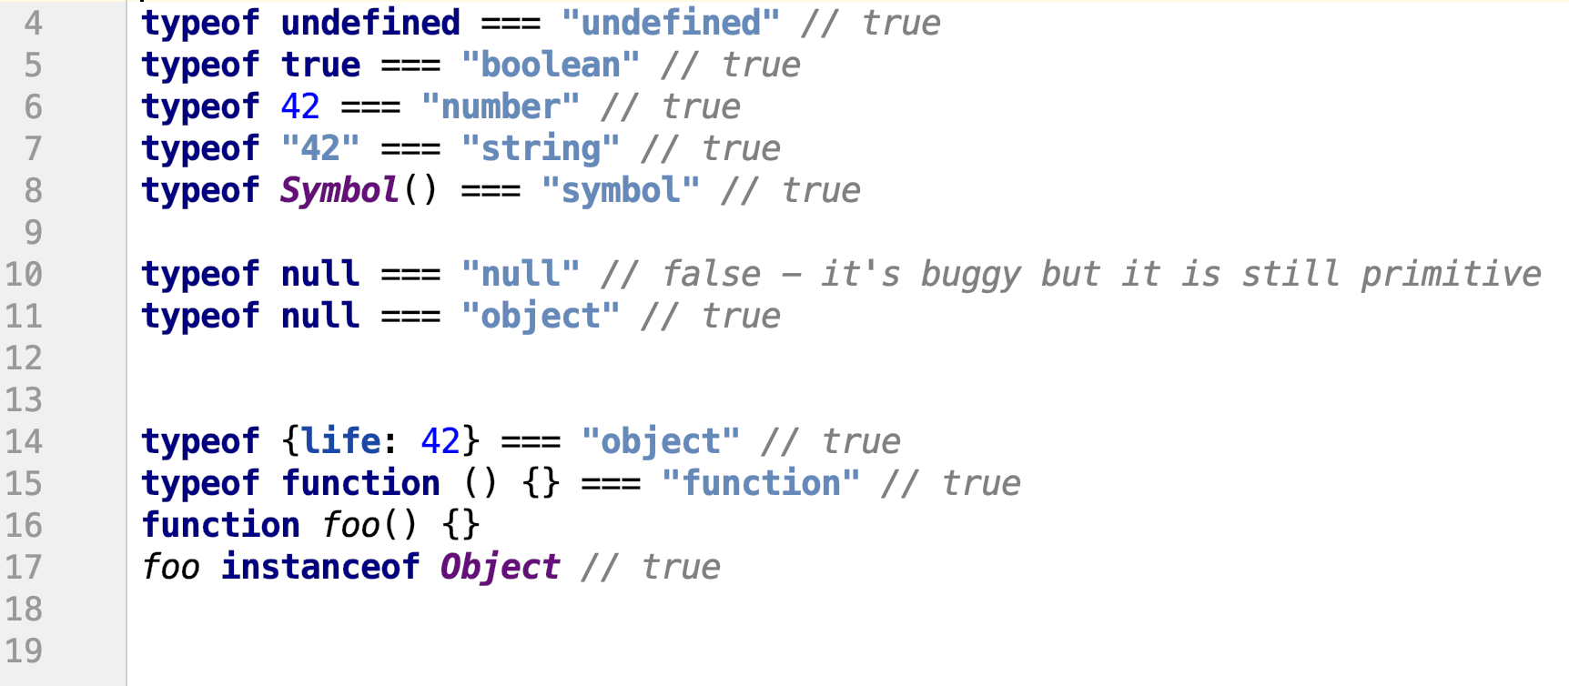
Types (revision)
6 primitives
string, number, boolean, null, undefined, symbol
operators: typeof, instanceof
Notes:
it is important to know that everything what is not primitive is object, except operators etc of cource
for example classes are syntax sugar for functions which are also objects
do not forget, that typeof null returns object, it is one of the oldest bugs in the JS and probably won’t be fixed, because it would make much more problems in the existing code

Slide 8
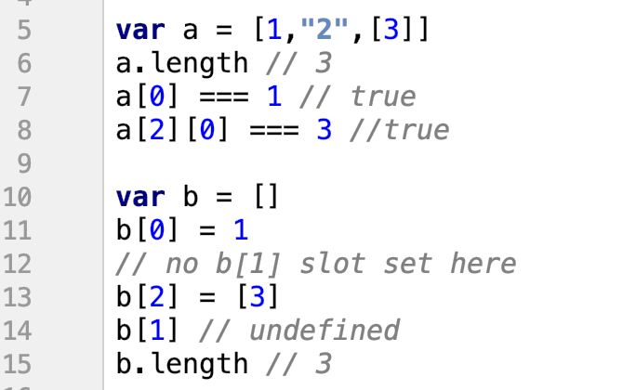
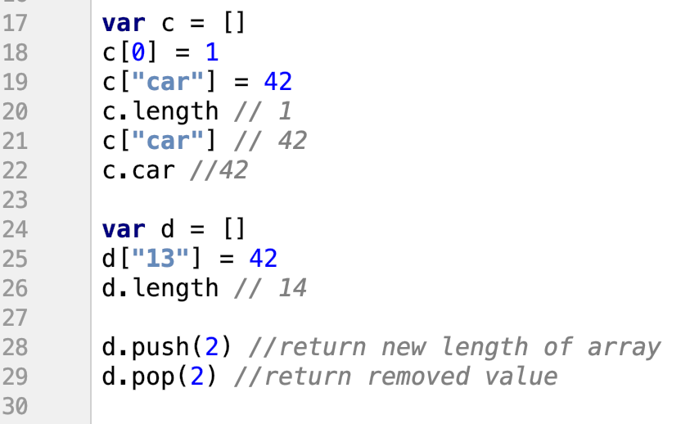
Array (revision)
arrays are still objects
numerically indexed
length based on highest index
na proměnný c může být uložený jak pole, tak objekt
Notes:
- arrays are still object, so we can do same things with them, but by default the are trying to convert a key, passed to the brackets, to a number
on the other hand, simple objects are trying to convert key to the string
length of the array are based on the highest index, so it is possible to have indexes without value -> undefined
prefer to use methods like push and pop instead of passing value manually to specific index, if it is possible

Slide 9
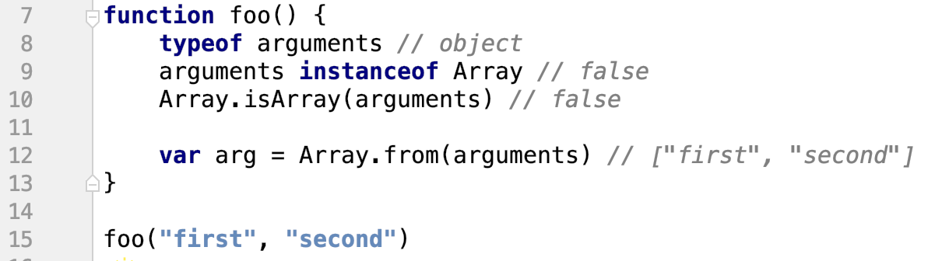
Array-like
objects that look like arrays but aren't
index access to elements
does not have array method such as push, indexOf, ...
v arguments jsou proměnný se kterými se volala funkce
Array.from udělá z proměnných pole
Notes:
these objects act in many ways as an array but they are not
most common one is argument, which might be from ES6 replaced with spread operator (more about it in the future)
allows to get all the params
it is preferred to convert array-like object to array instead of working with array-like object directly

Slide 10
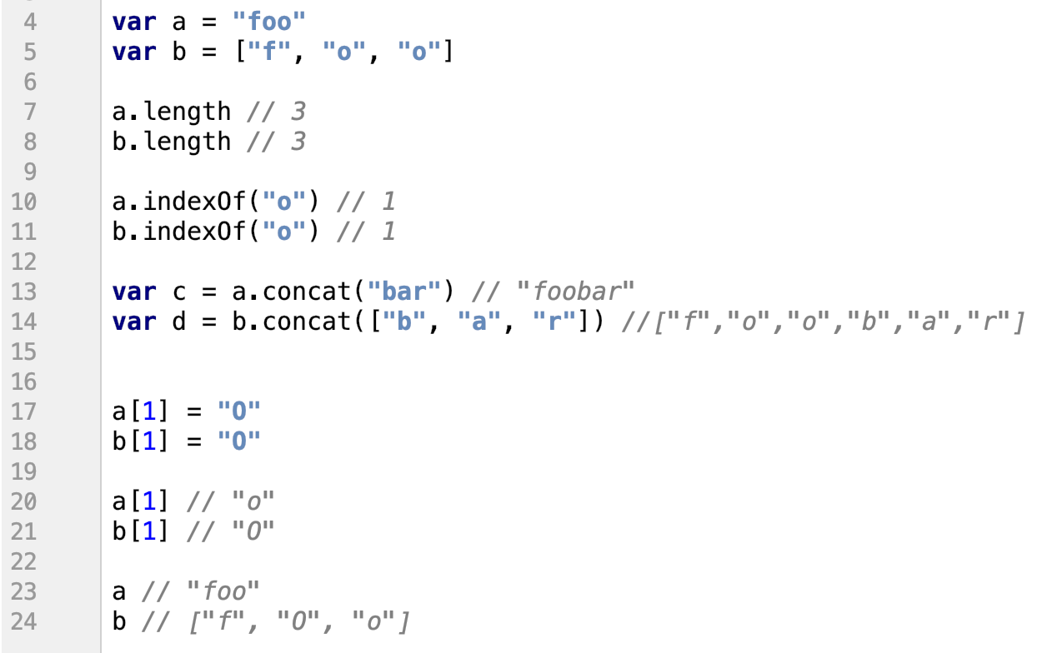
String
strings are not arrays of chars
strings are immutable
pozor, pokud voláme na stringu length, vytvoří se objekt String a potom pokud budeme porovnávat běžný string s objektem string na ===, tak to vrátí false
Notes:
- strings are immutable so you cannot modigy just part of them
to update string, you need to create a new one
strings are not just array of churs even if they have many identical methods

Slide 11
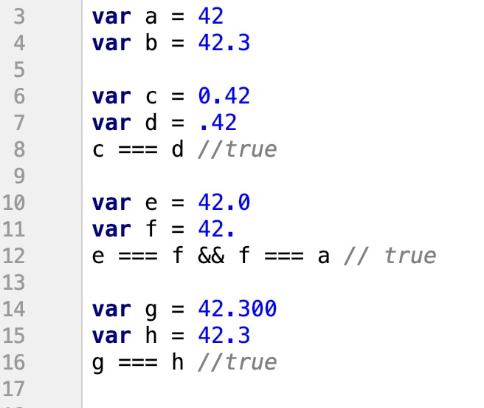
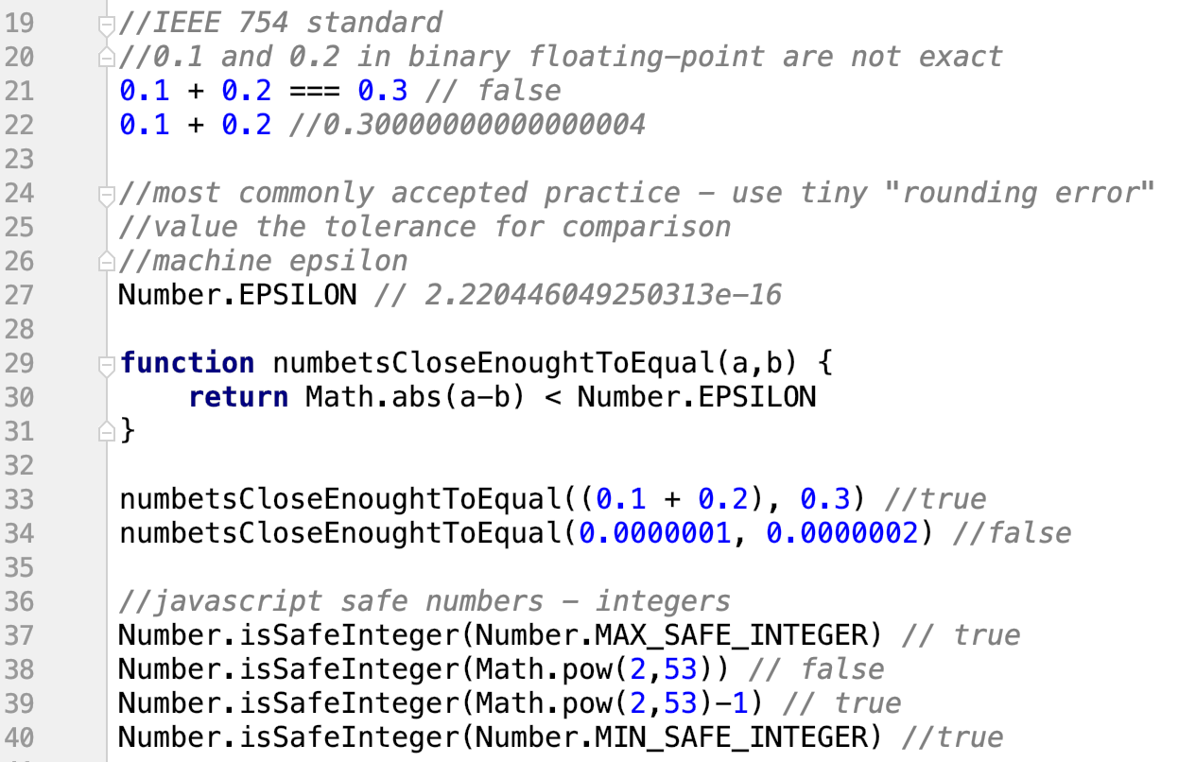
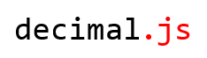
Number
only one data type for numbers, it contains integer, double, float, etc
dá se zapsat stejná hodnota
počítání skrze tuhle knihovnu, jinak to počítá nesmysly
Notes:
numbers can have many to write them, but for the readibility, we should not use all of them
due to standard IEEE 754 there is only limited binary accuracy
to prevent that problem there are several solutions:
round the result – if the difference is less than Number.EPSILON, then it is probably caused by the mentioned problem
another solution is to use library like decimal.js which is able to do mathematical operation without limited accuracy
but if the numbers are integers (witout floting-point) then you are safe if these values in between Number.MAX_SAFE_INTEGER and Number.MIN_SAFE_INTEGER

Slide 12
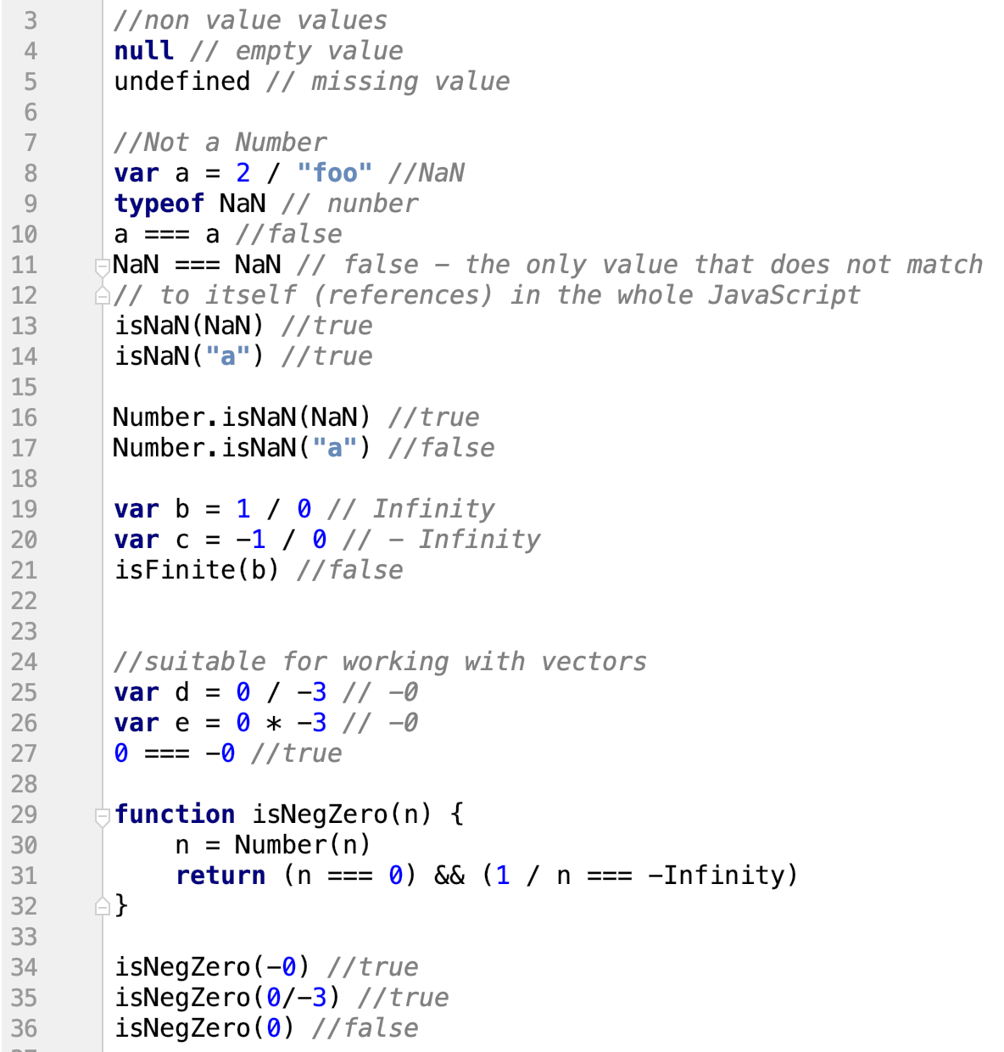
Special values
pokud chceme zjistit, jeslti je něco hodnota null nebo undefined, stačí tu proměnou hodit do ifu (proměnná)
Notes:
null represents empty value which was explicitly set
udefined is missing value, so it was deleted or never was there
NaN is special type of number, only value which is not equal to itself in JS
Infinity
-0,0,+0
problem is that -0 === +0 returns true

Slide 13
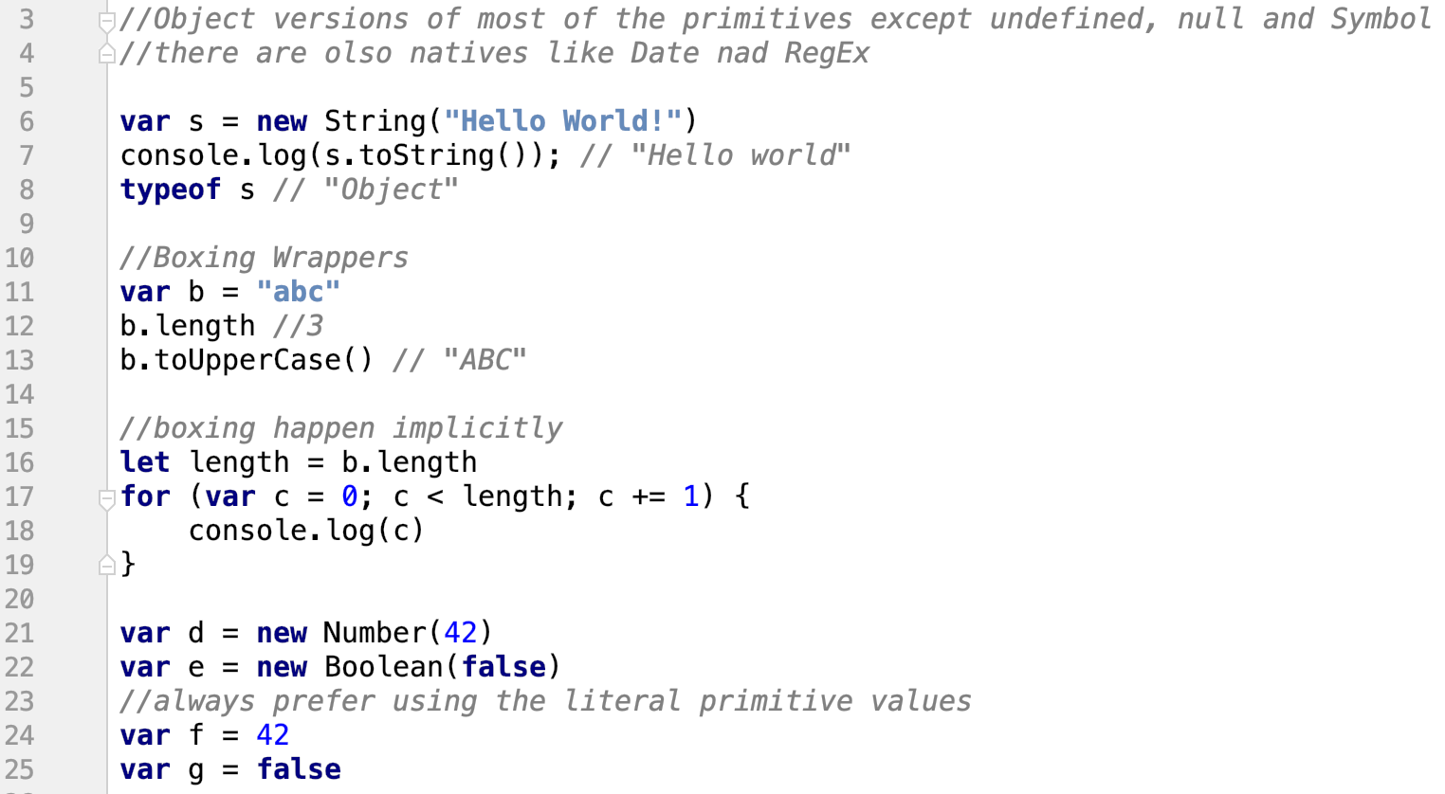
Natives
Notes:
object version of primitive tipes
allows to perform implicitly boxing to call methods on primitives
it can be done explicitly but it is not recommended, let the JS do it itself, it is faster

Slide 14
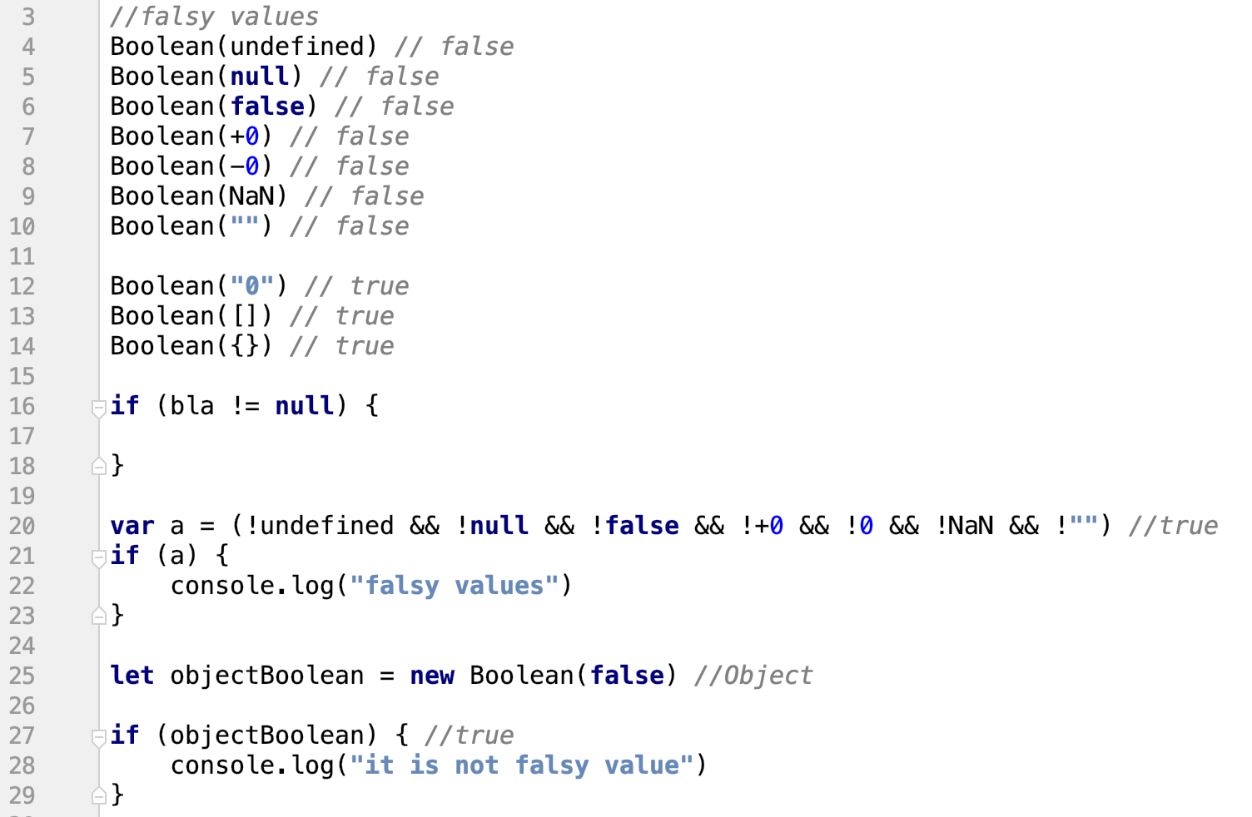
Falsy values (revision)
jediné hodnoty v JS, který jsou false

Slide 15


Bang, Bang!!
bang je ten samotnej vykřičník
The first shot - a single bang!
The second shot - double bang!
když zkusíme, jestli je něco truthty value if(a), tak to máme akorát pro podmínku, pokud ale chceme z toho vrátit boolenovskou proměnnou, tak na to použijeme let b = !!a a ono to vrátí true, pokud to není false value
Notes:
bang bang bang!

Slide 16
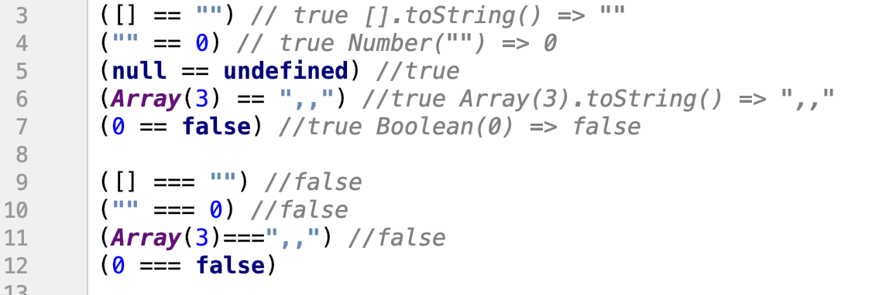
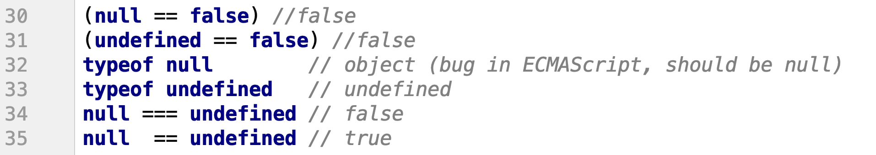
== and === (revision)
always prefer to use ===
Notes:
ass you can see, it simplier to use === without coercion

Slide 17
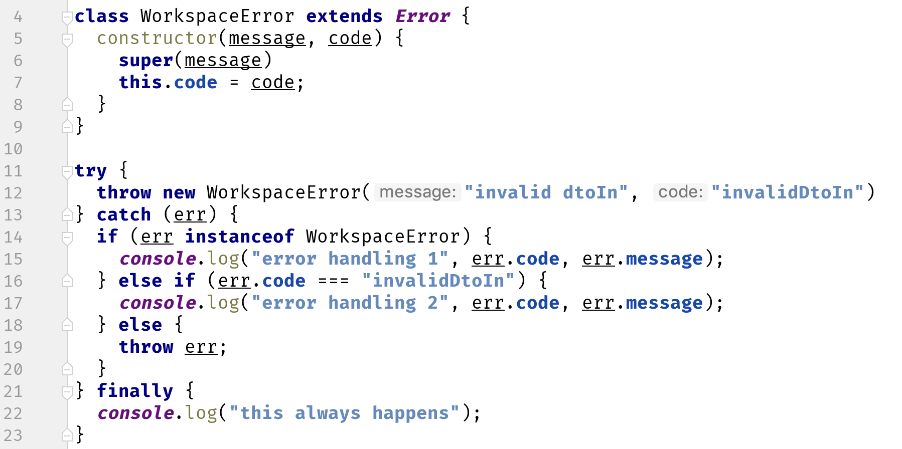
Error handling
you can't catch only specific errors
Notes:
- you cannot handle only single error in the JS in catch, you have to handle it in the logic yourself, most common is that you check if it is instance of some abstract error or using code

Slide 18
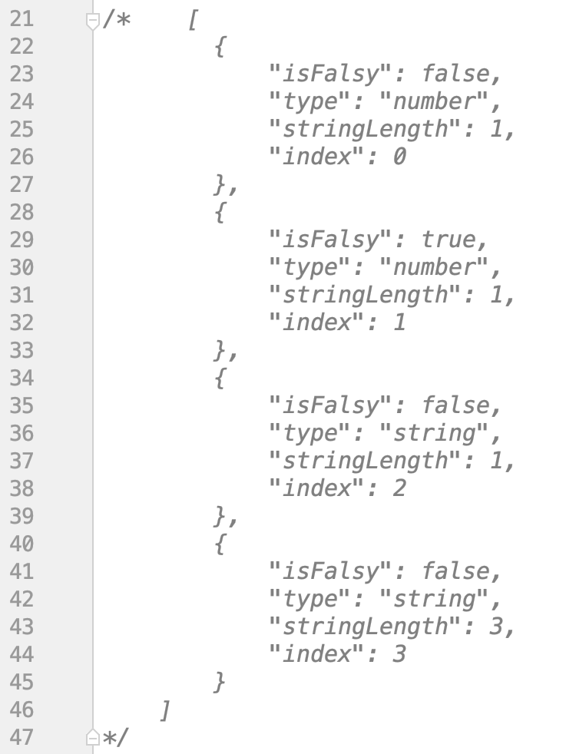
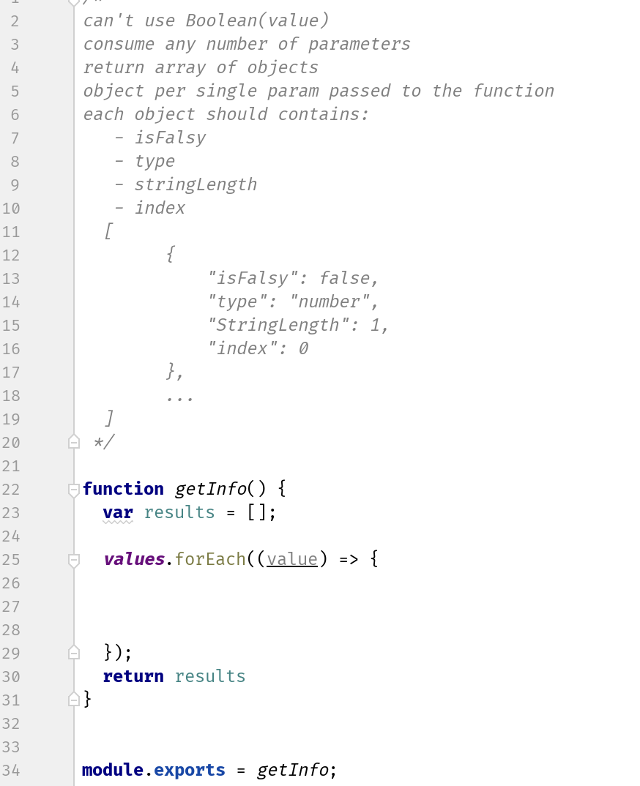
Exercise 1
npm test -- exercise-1.test.js

Slide 19
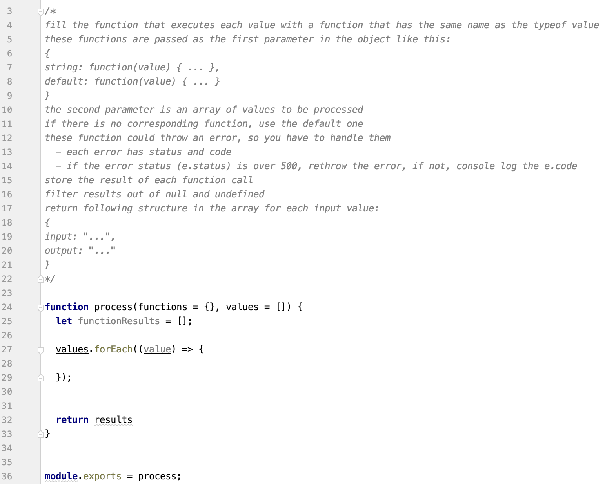
Exercise 1 - bonus
npm test -- exercise-1-bonus.test.js

Slide 20
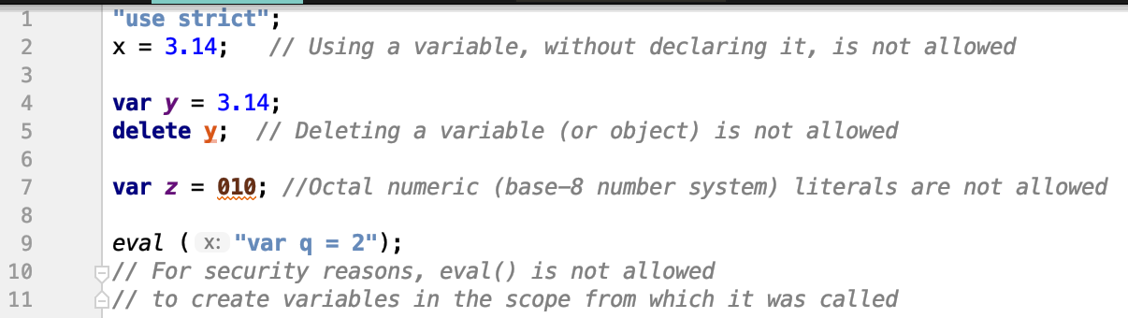
Strict mode
"use strict";
Strict mode is declared by adding to the beginning of a script or a function
to indicate that the code should be executed in "strict mode".
to write "secure" JS
it changes previously accepted "bad syntax" into real error
Notes:
strict is recommended to be used everywhere to prevent using deprecated and bad syntax

Slide 21
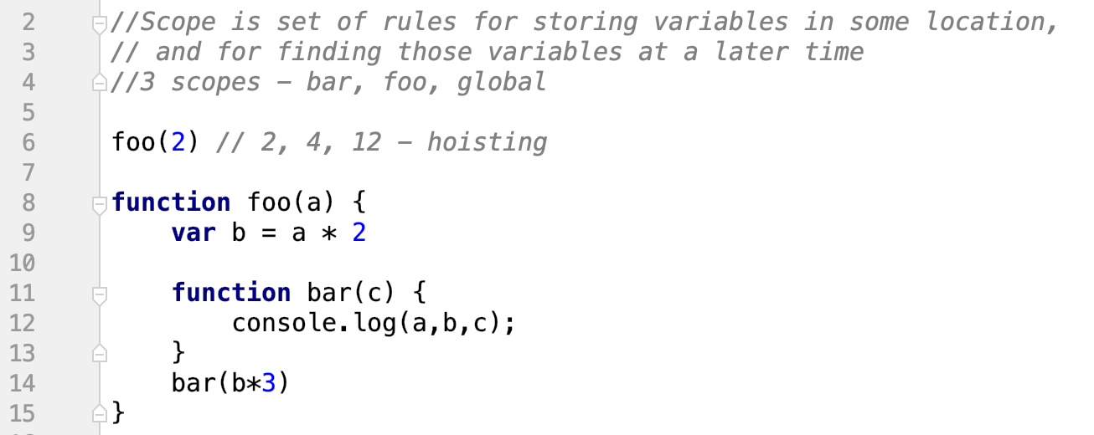
Scopes
Notes:
- it is set of rules for storing variables in some location and for finding those variables at a later time
hosting is process when declaration of each function are moved to the top of that file

Slide 22
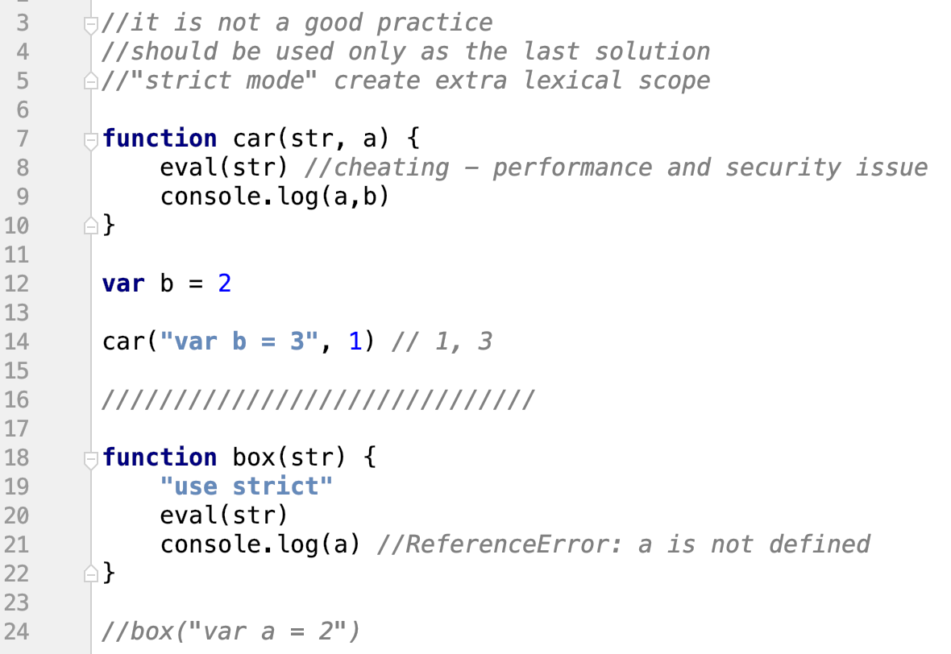
Cheating with eval
Notes:
- eval allows to execute code from string
- js compilator skip the process for performance optimalization so it is performance and security issue, that is why it should not be used

Slide 23
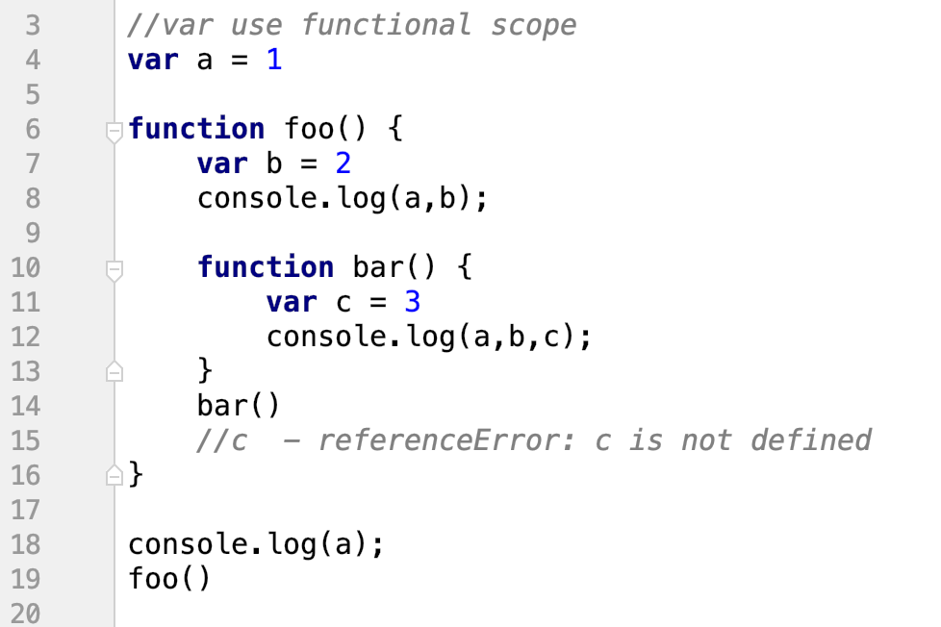
Functional scope
Notes:
functional scope had been in JS long time before block scope
variable exist in the scope of the function, even if it was defined in a nested block

Slide 24
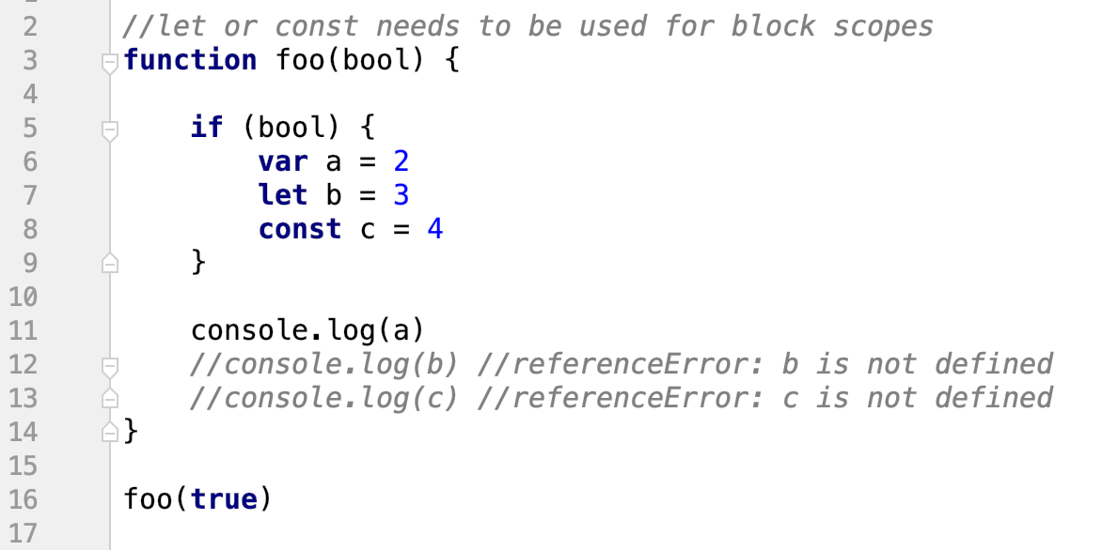
Block scope
let - proměnná omezená jenom na blok, ve kterém je
var - proměnná je omezená na celou function
Notes:
block scope works with variables declared using let/const only

Slide 25
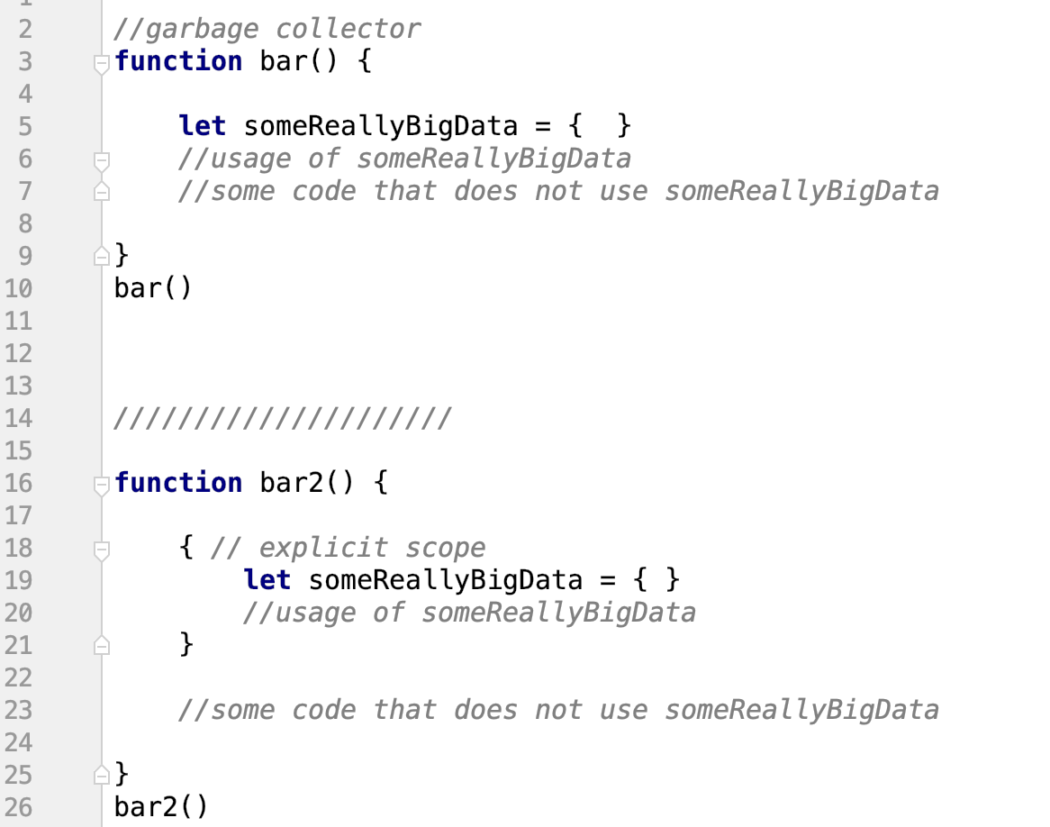
Extra garbage collection
můžeme dát i prázdný { } do kterého dáme nějaký proměnný pro daný scope díky čemuž můžeme ušetřit paměť (garbage collector)
Notes:
- JS Garbage Collector is based on scopes

Slide 26
How to reuse code?
Copy paste?
Multiple files?
External modules?

Slide 27
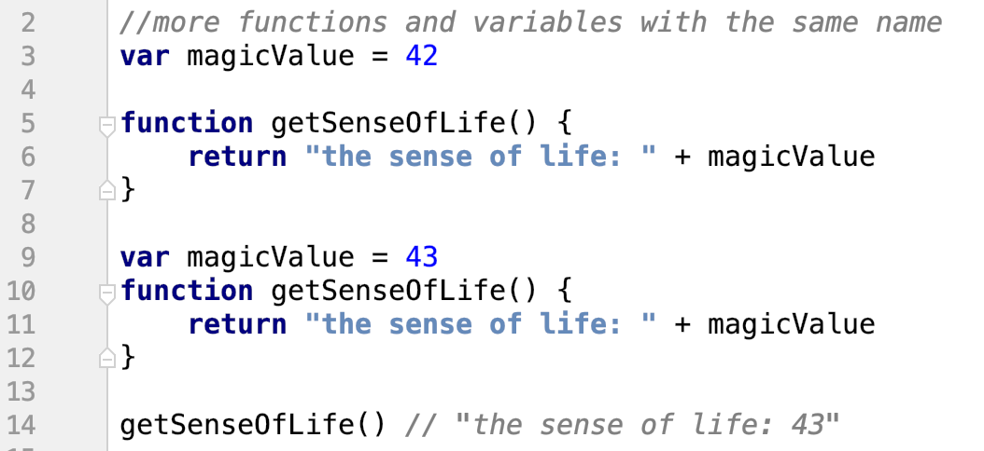
Global namespace - problem
Notes:
- we need to find a way to reuse code from someone else

Slide 28
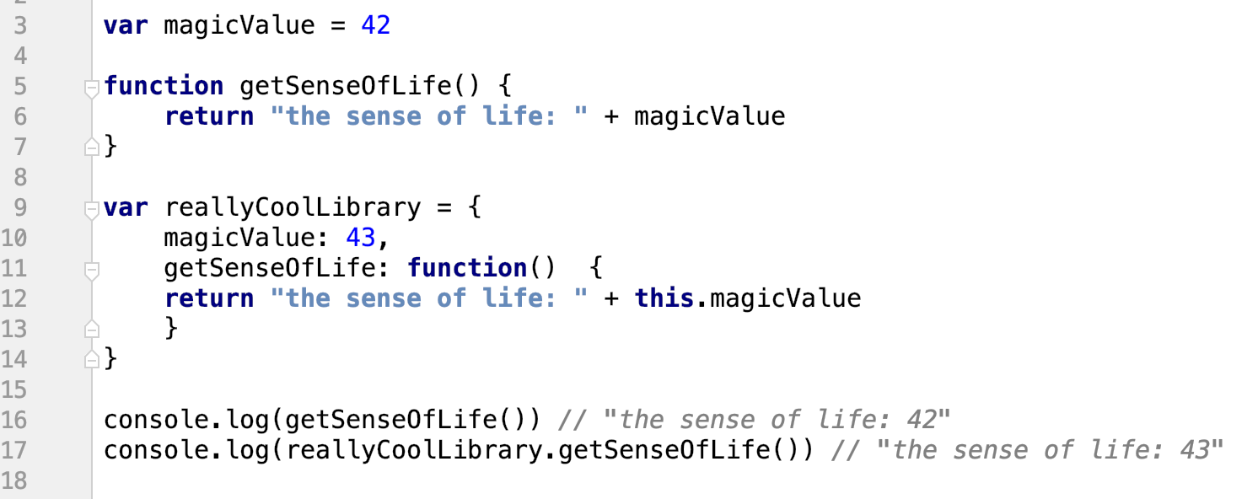
Global namespace - solution
řešením je vložit funkci do objektu, kterej si pracuje už s vlastníma hodnotama
Notes:
- first sollution was by nesting into an object

Slide 29
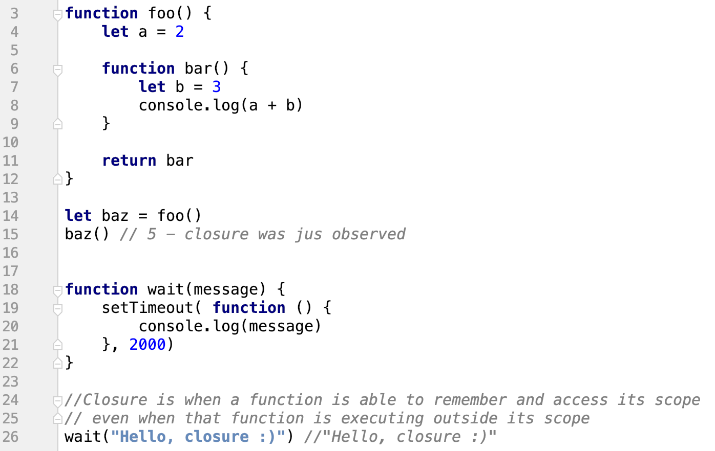
Closures
můžeme vrátit funkci, ale ta funkce si pamatuje svůj scope, tzn. hodnotu let a si bude pamatovat “navždy”
Notes:
- closure is when a function Is able to remember and access its scope even when that function is executing outside its scope

Slide 30
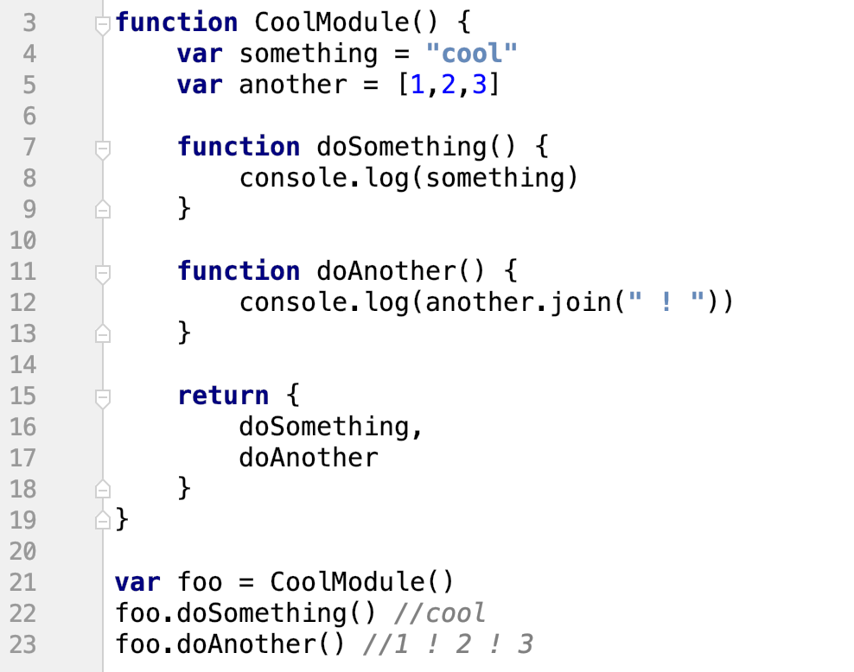
Modules
ekvivalent tříd - např u knihoven nás nezajímá, jak to funguje ve vnitř, ale jenom volám funkci
Notes:
- the first modules were actually just functions using closure

Slide 31
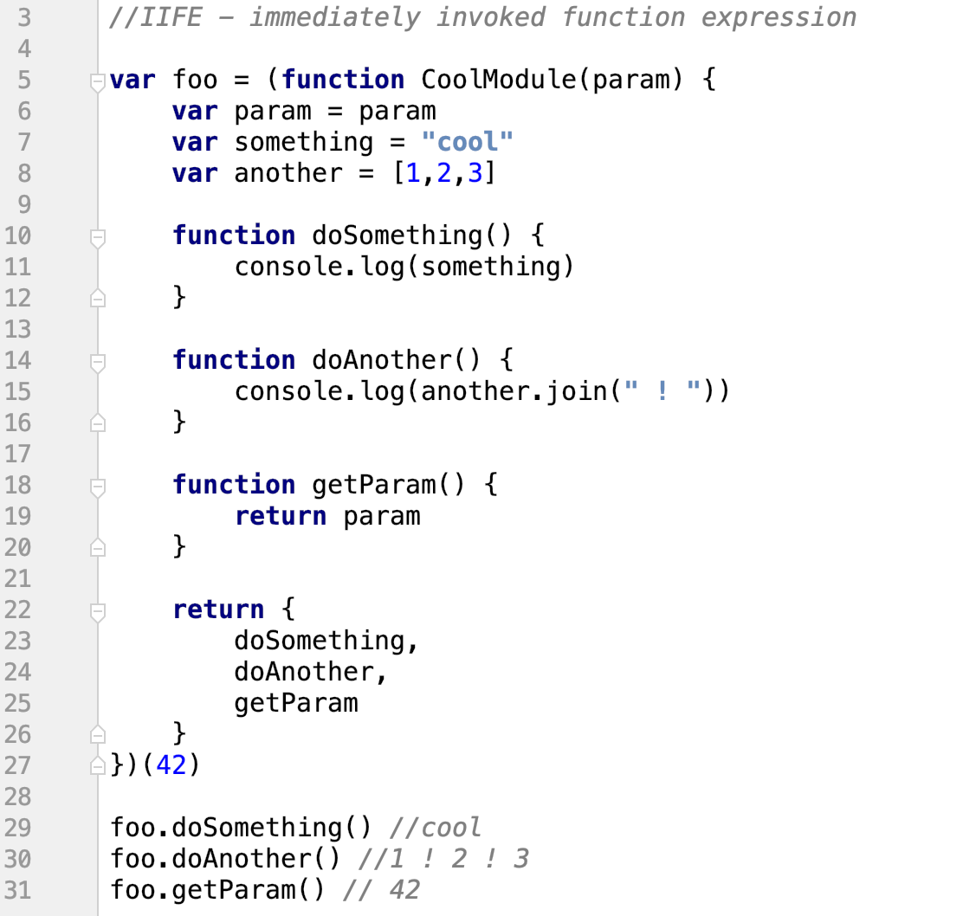
IIFE

Slide 32
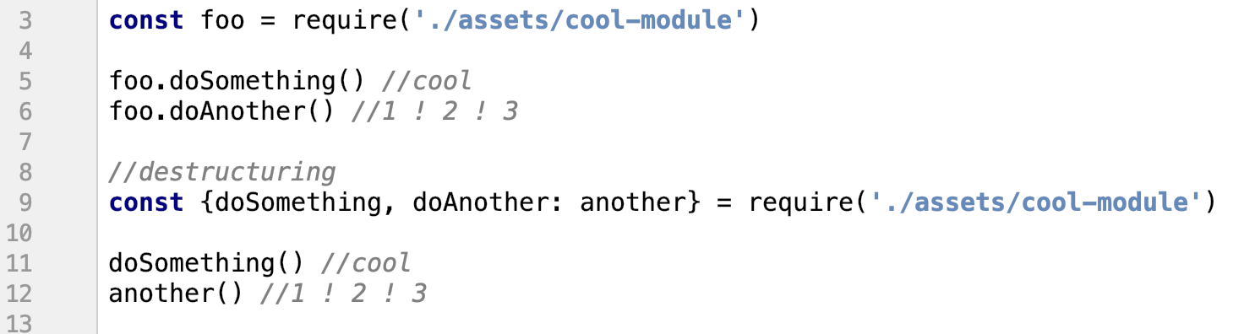
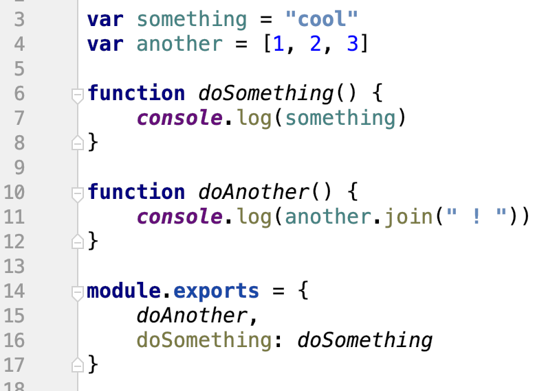
Require
tady se stanoví, co se má v rámci modulu exportovat
2 způsoby jak předat do objektu něco pod daným klíčem,
doAnother je to samý jako doAnother: doAnother
module.export se používá vždy, konvence
Notes:
- Node.js modules are based on these princips
– require – to load file
- export – to define what should be load from that file

Slide 33
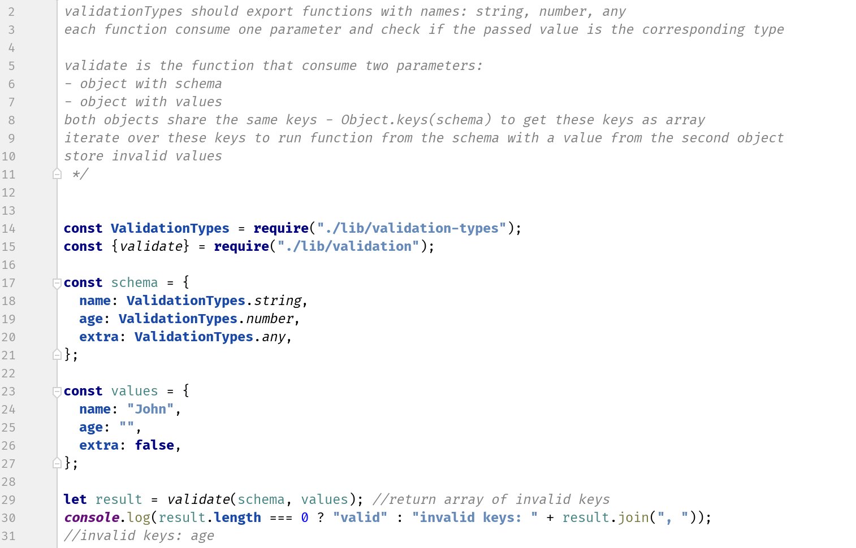
Exercise 2
npm test -- exercise-2.test.js

Slide 34
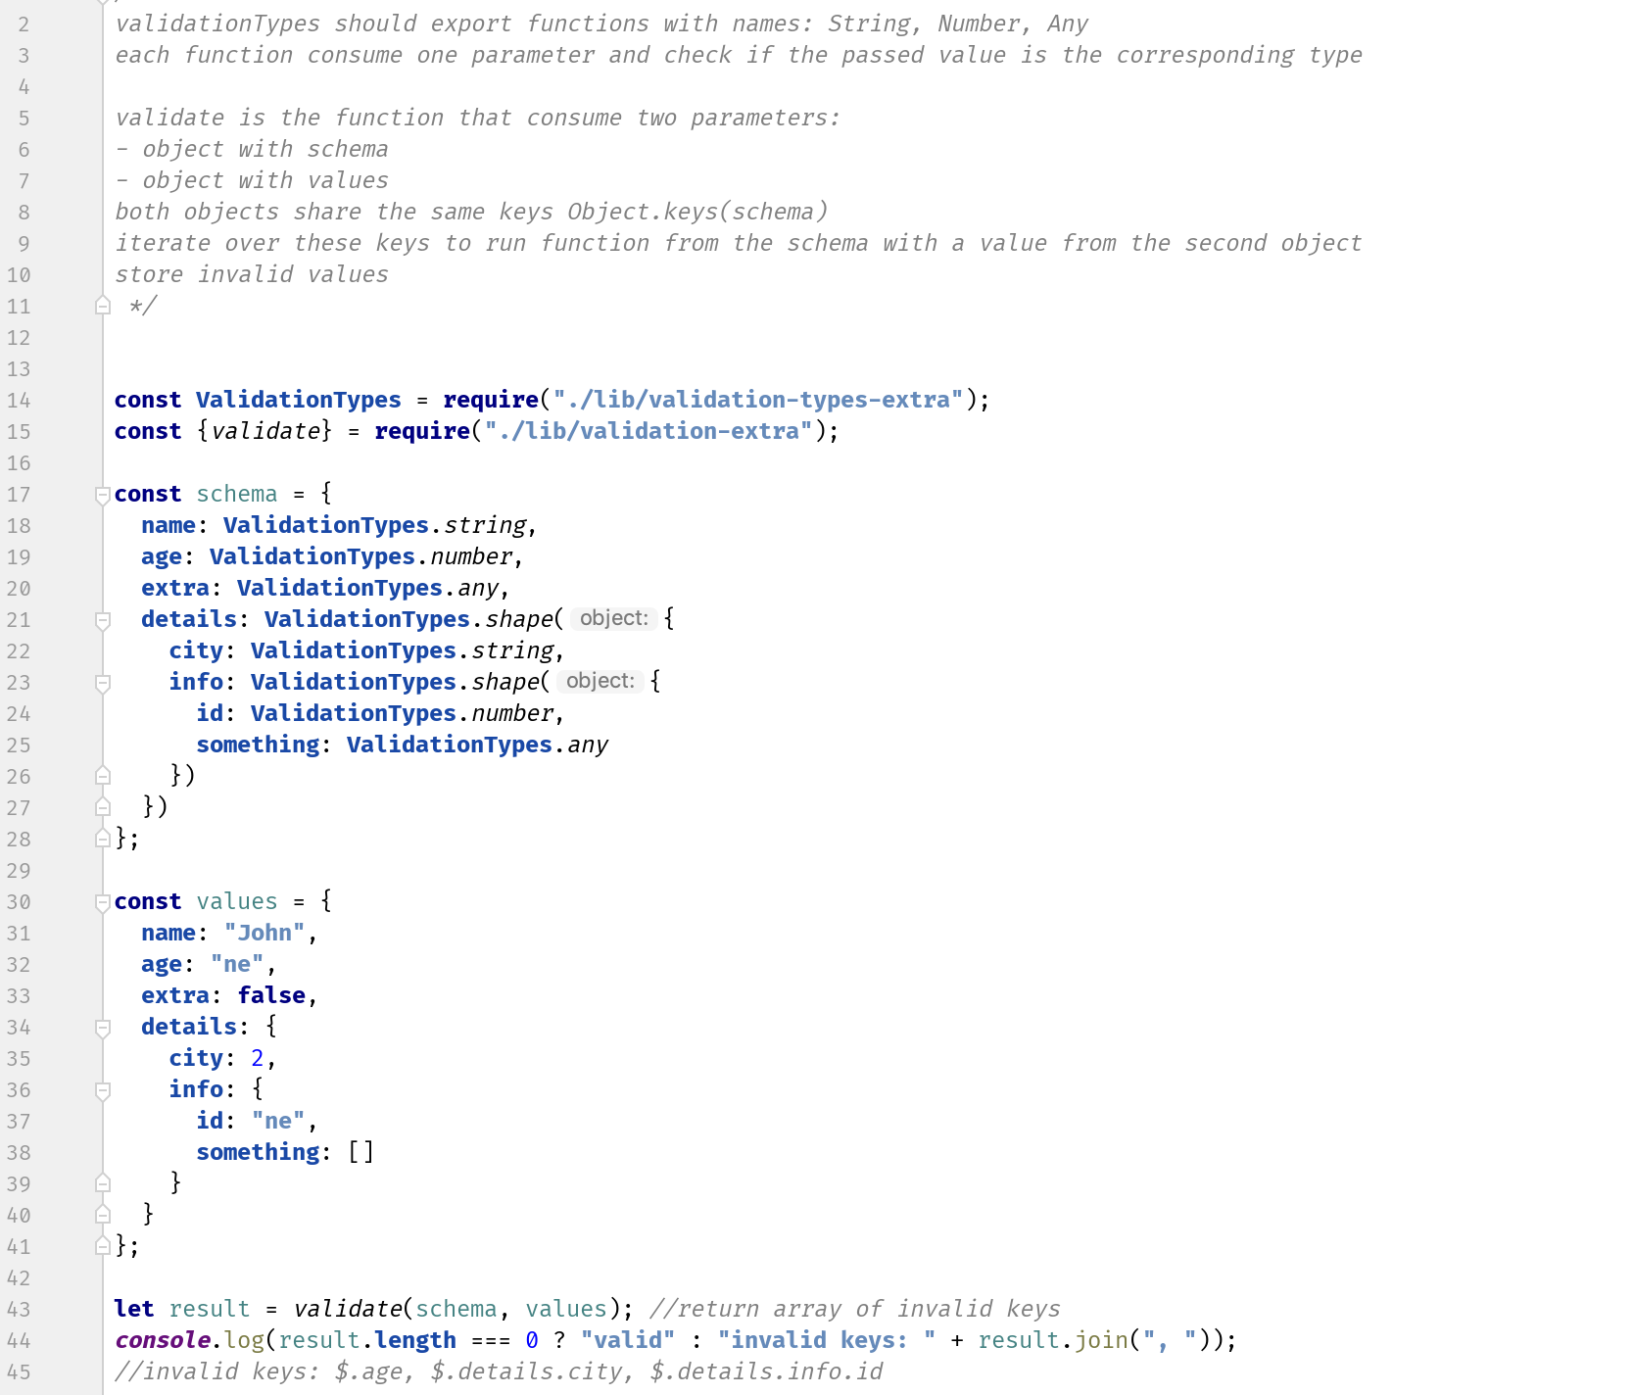
Exercise 2 extra
npm test -- exercise-2-bonus.test.js

Slide 35
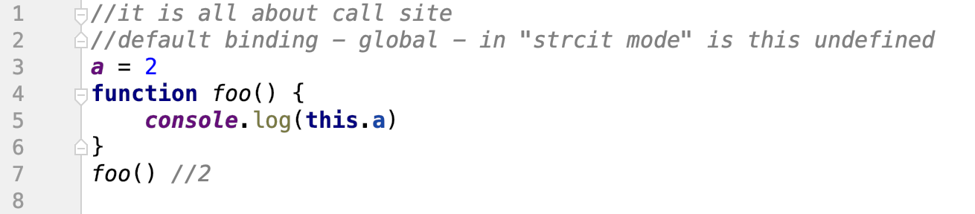
Binding - default
"strict mode"
this
takhle se už nepoužívá
Notes:
default binding we should not use, because we do not want to interact with global object if there is any other sollution
In strict mode it is not even possible

Slide 36
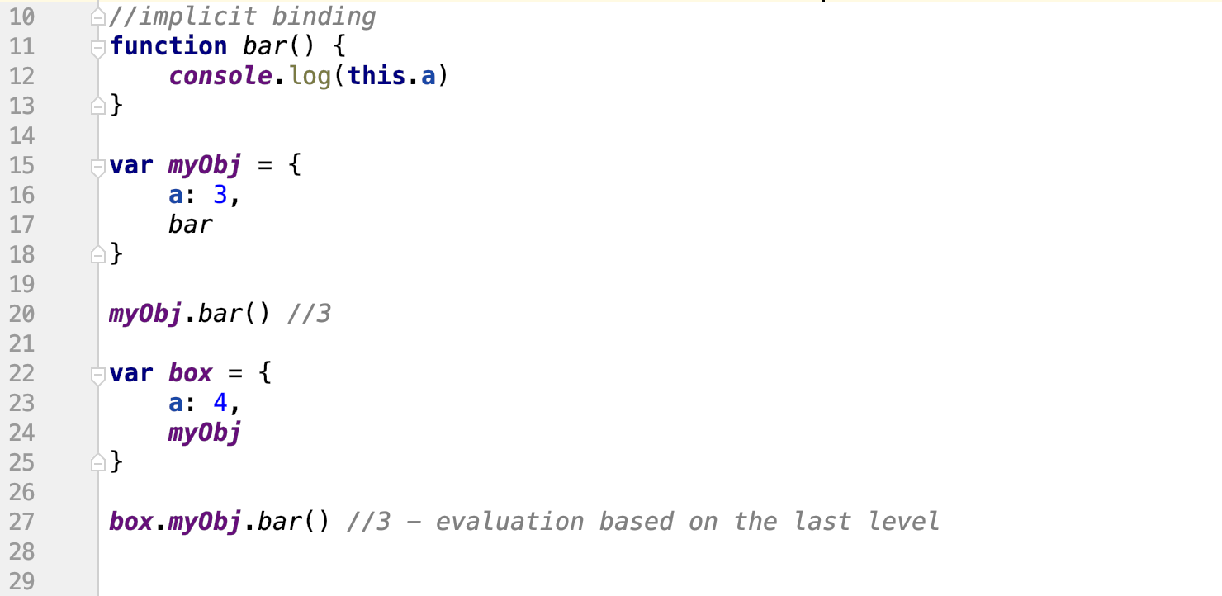
Binding - implicit
pokud se spojí s objektem, stává se pro this ten objekt
Notes:
- implicit binding is more common than default binding, it rely on that function is part of the object, but make sure, that you know, what you are doing

Slide 37
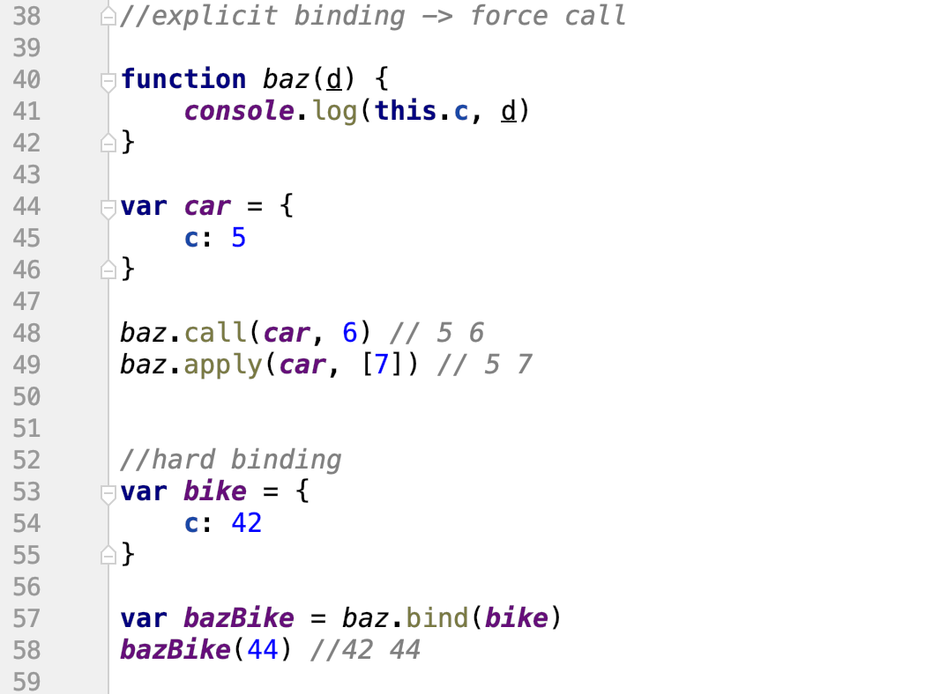
Binding - explicit and hard
call říká zavolej fukci baz v kontextu car s parametrem 6
V kontextu to znamená, že při volání this se použíje objekt car
apply to samý, ale parametr se předává v poli
tohle řekne, že vždycky, když se bude volat bind, tak se vždycky bude volat v kontextu bike
už se nepoužívá, dřív akorát v Reactu
Notes:
- explicit binding/hard binding is the way we want to use, because we directly control, what is going to happen

Slide 38
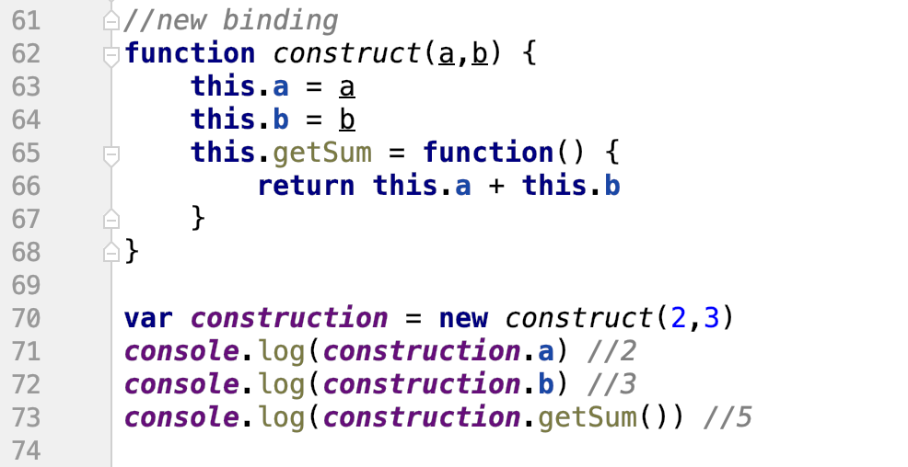
Binding - new
v případě new teprve vzniká kontext, kde můžeme nastavit this
Notes:
- new binding allows to simulate, that there are classes in JS, but they are still a functions

Slide 39
Binding review (TL;DR)
1) Is the function called with new (new binding)? If so, this is the newly constructed object.
var bar = new foo()
2) Is the function called with call or apply (explicit binding), even hidden inside a bind hard binding? If so, this is the explicitly specified object.
var bar = foo.call( obj2 )
3) Is the function called with a context (implicit binding), otherwise known as an owning or containing object? If so, this is that context object.
var bar = obj1.foo()
Otherwise, default the this (default binding). If in strict mode, pick undefined, otherwise pick the global object.
var bar = foo()

Slide 40
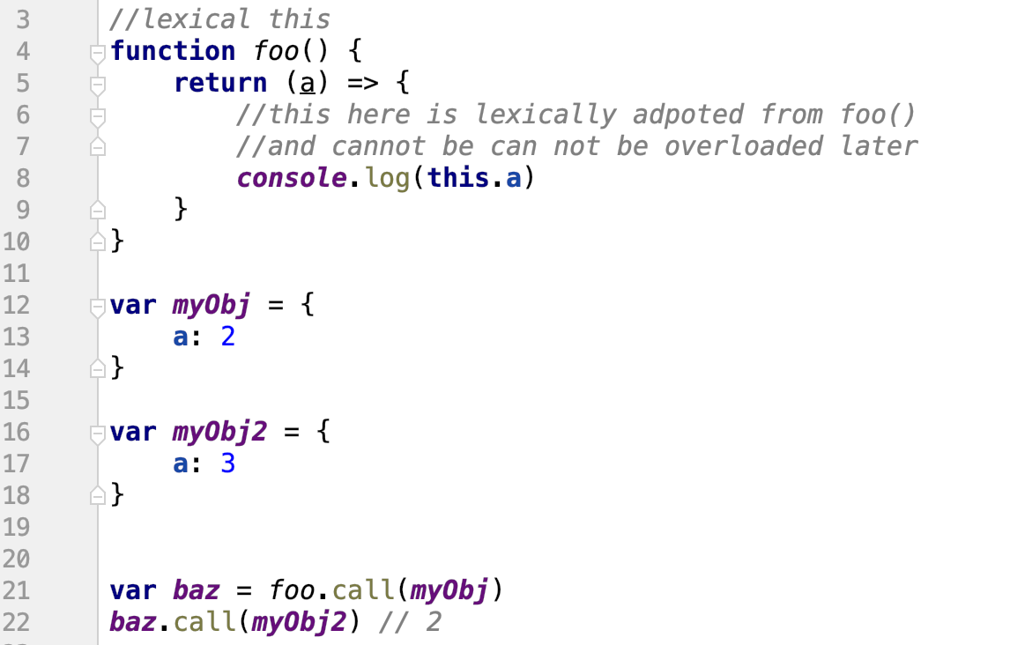
Lexical this
Notes:
- arrow functions are different in the way they work with THIS, they inherit it content from outer scope, in this case, it is function foo and cannot be overloaded later

Slide 41
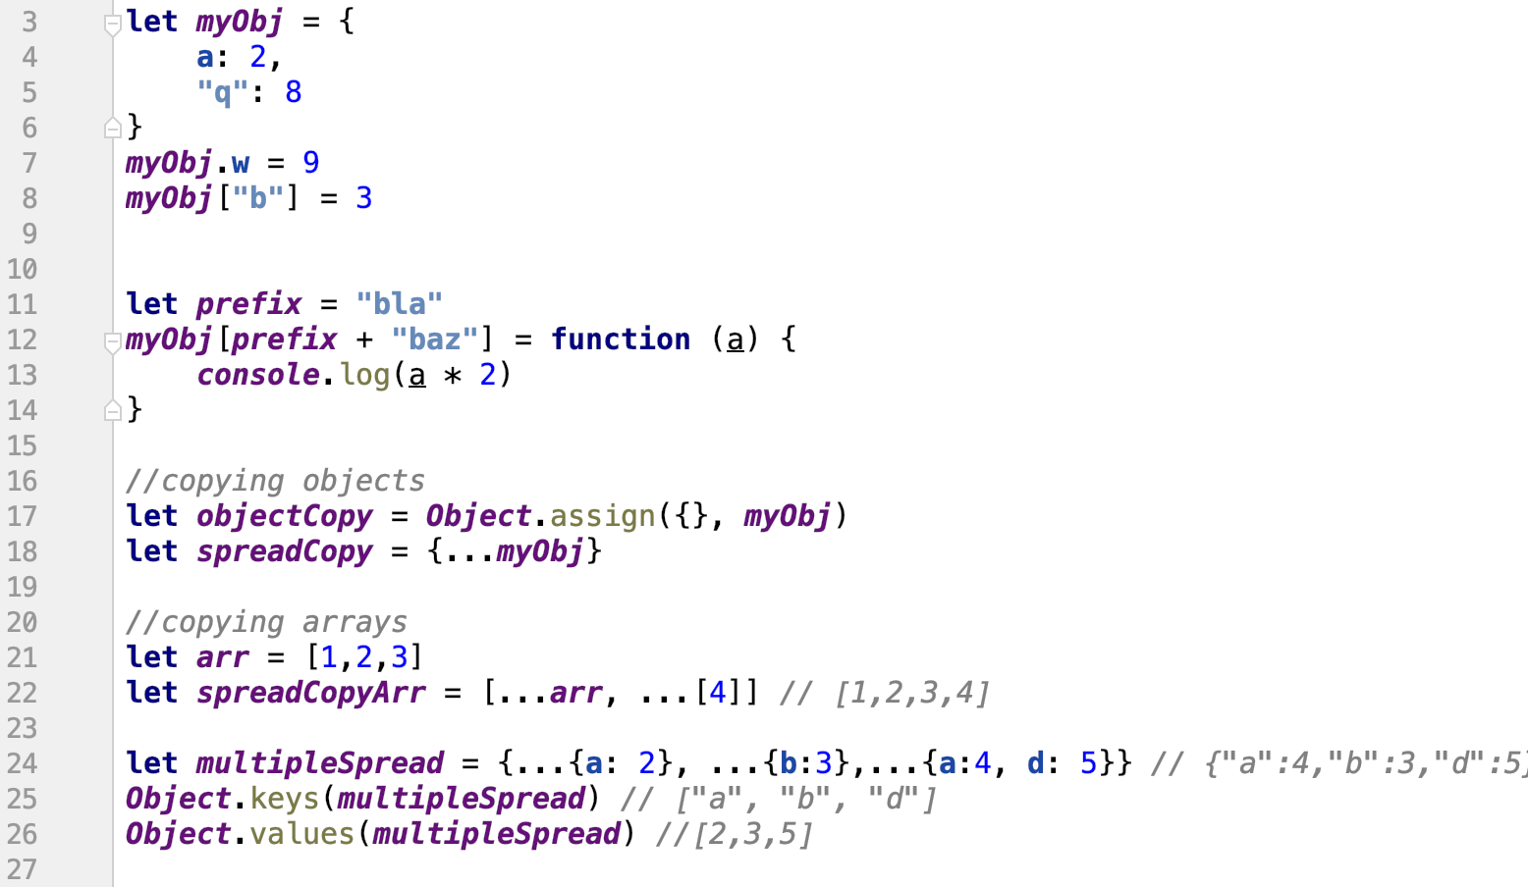
Object 1
kopíruje objekty - vezme parametry za ... a ty použije pro novej objekt
kopíruje stejně tak pole, případně můžeme přidat další hodnoty, do parametru
Notes:
- object.assign vs spread operator for object duplication

Slide 42
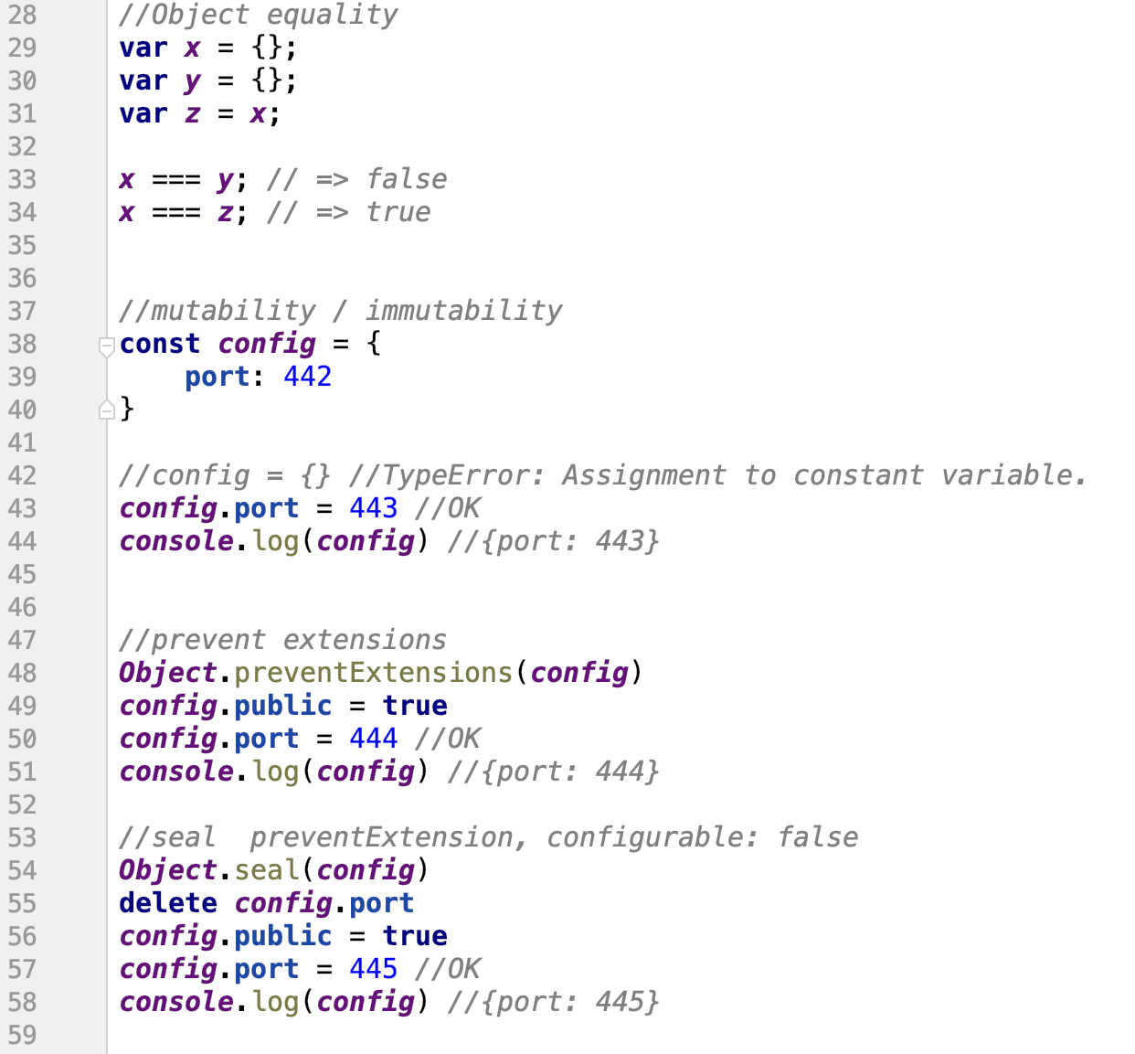
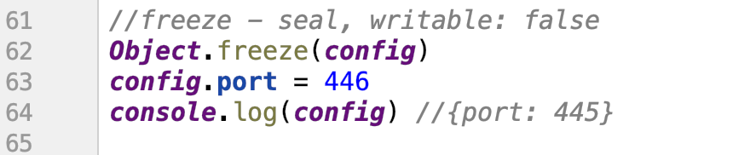
Object 2
porovnává referenci
zabrání přidávat další hodnoty objektu
zabrání přidávat mazání hodnoty objektu
zabrání změně hodnoty objektu
Notes:
two object variables are equal only if they point to the same object (same reference)
object defined with const can me still modified, so there are options how to prevent it – prevetExtensions, seal, freeze

Slide 43
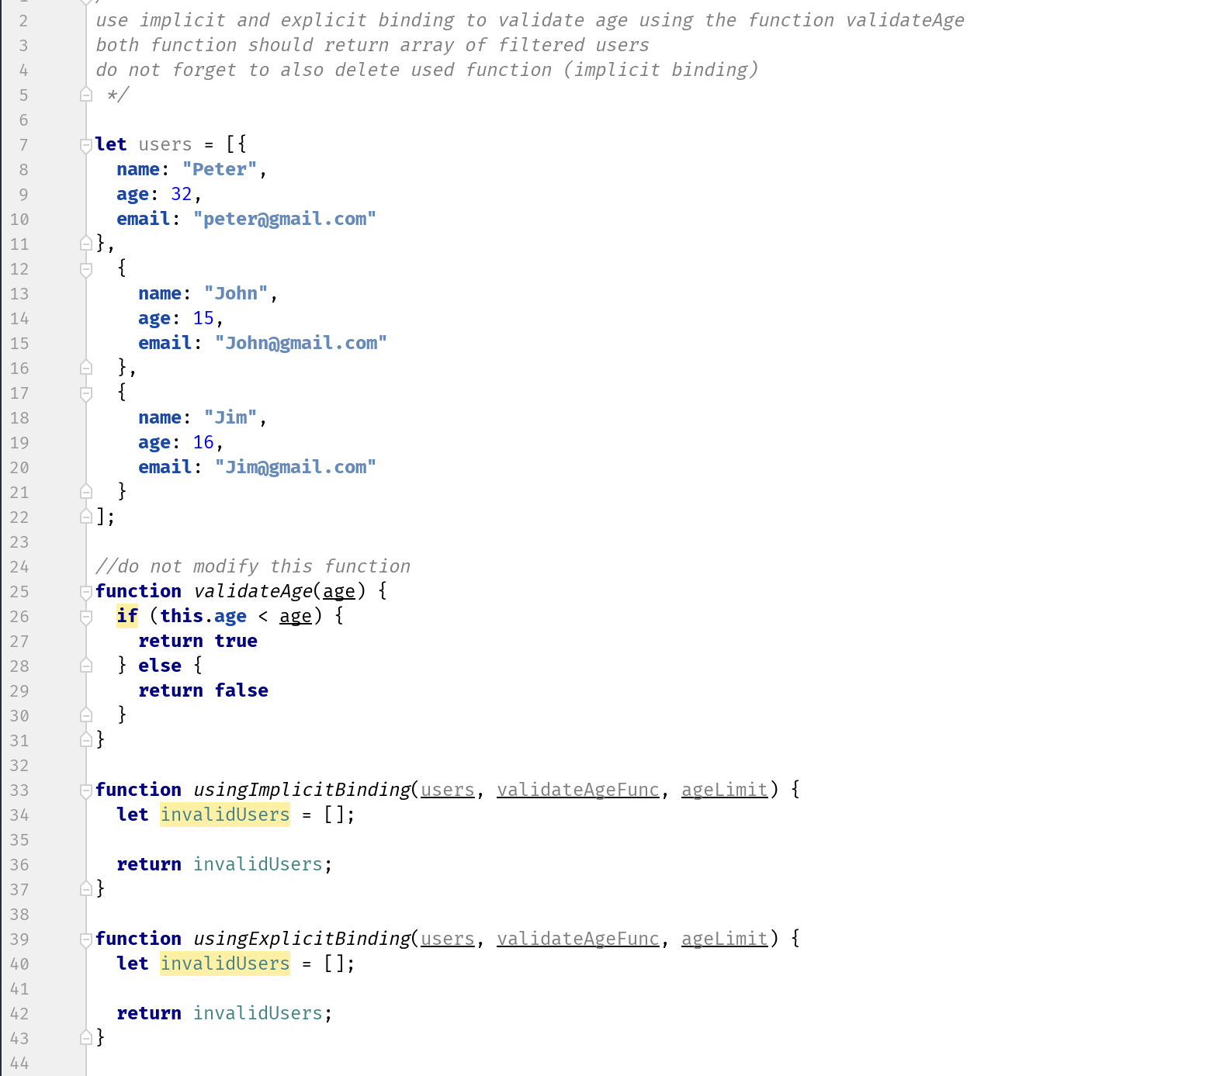
Exercise 3
npm test -- exercise-3.test.js

Slide 44
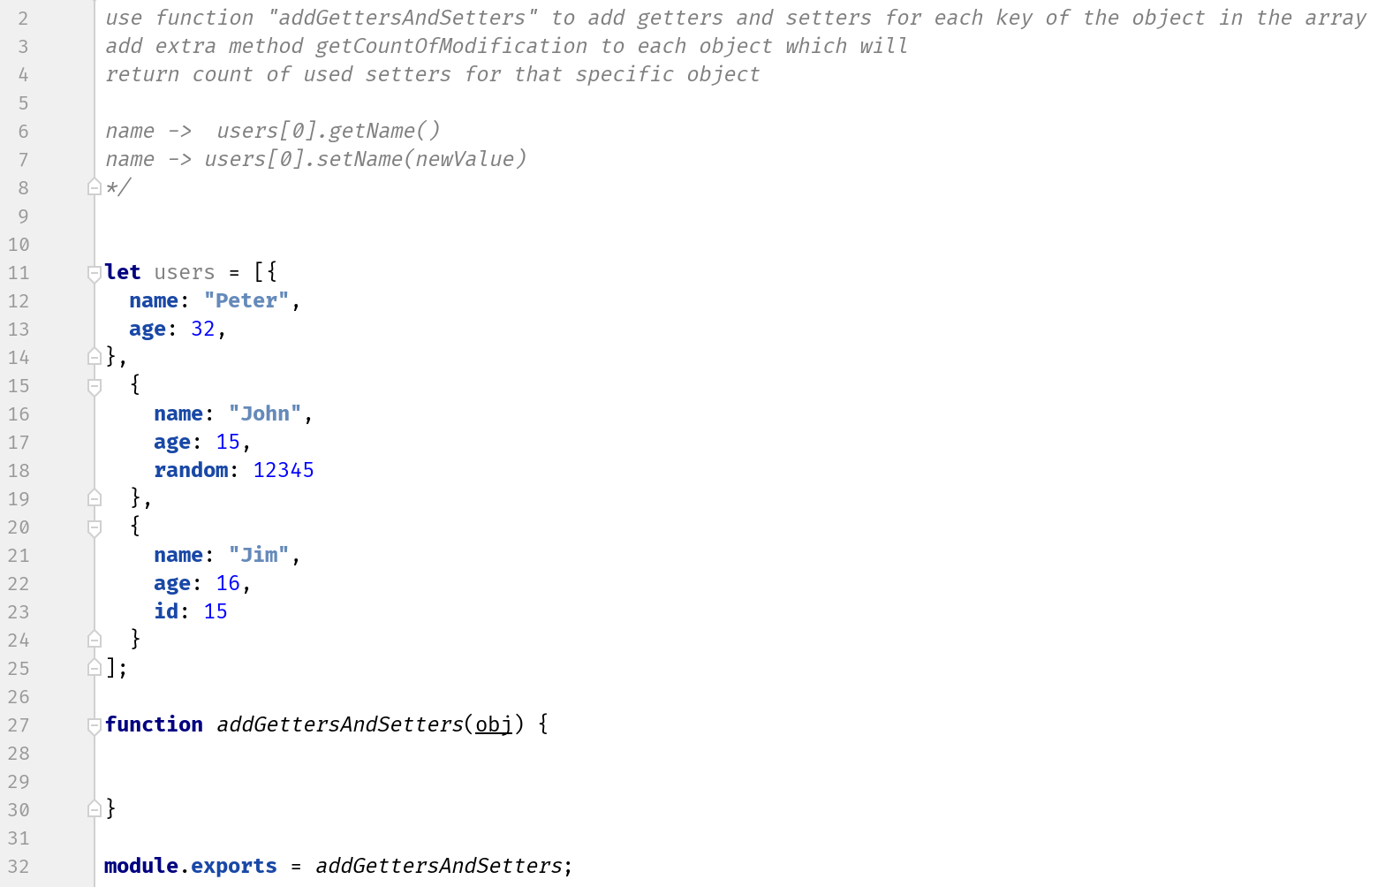
Exercise 3 - bonus
npm test -- exercise-3-bonus.test.js

Slide 45
Binding - new

Slide 46
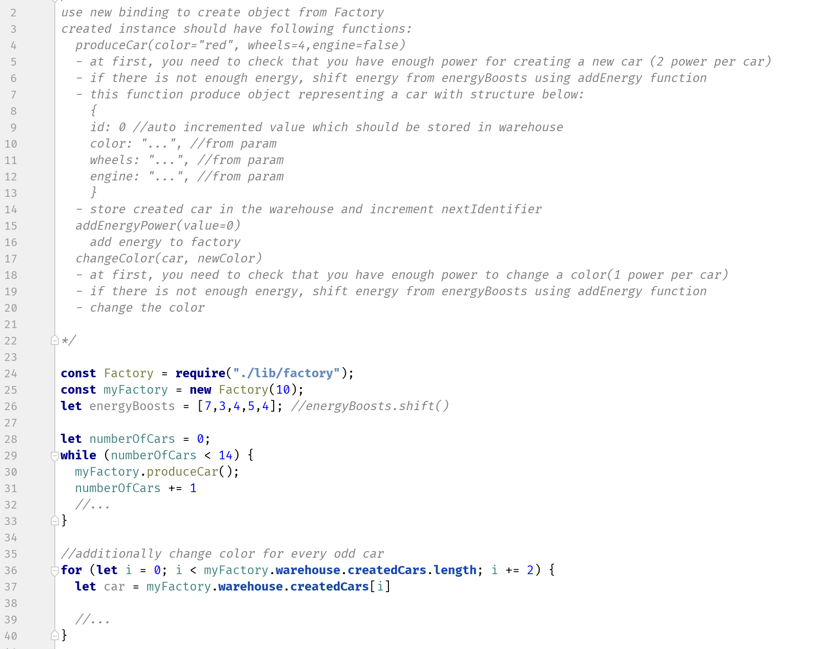
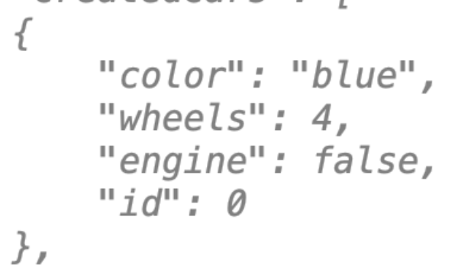
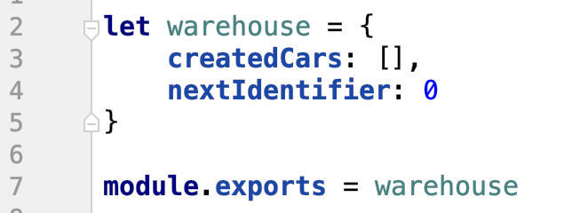
Exercise 4
npm test -- exercise-4.test.js

Slide 47
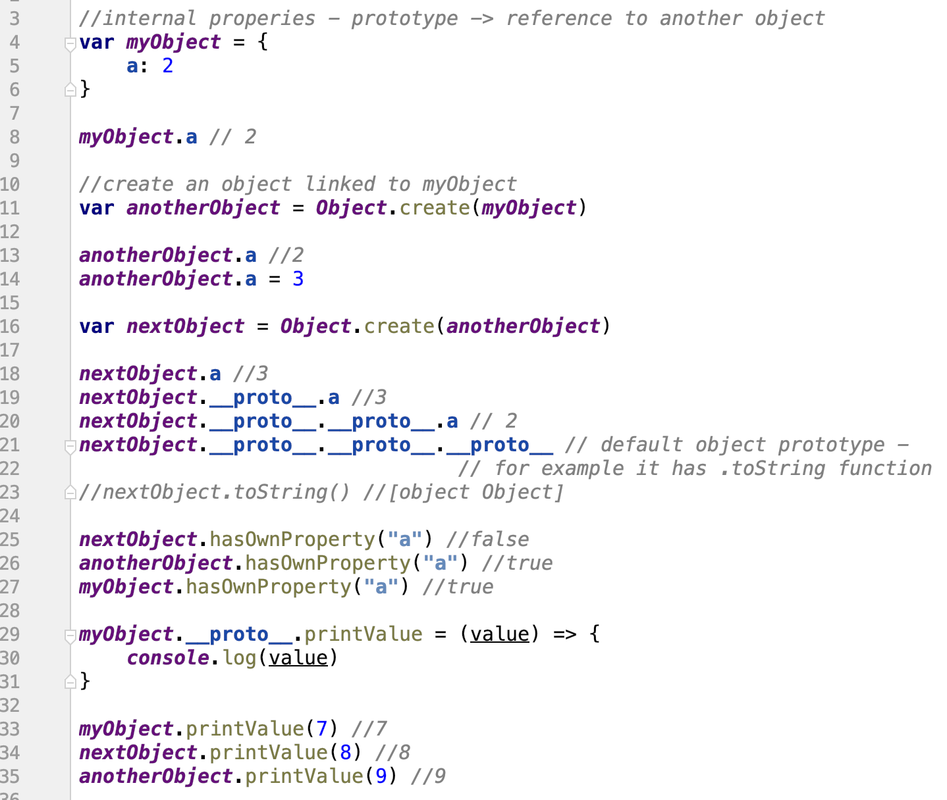
Prototype 1
vytvoří kopii objektu
ptá se na hodnotu objektů těch předchůdců
zeptá se, jeslti to je jejich hodnota, nebo zděděná
Notes:
prototype is reference to another object
if JS wont find property/function on specific object, it goes through the prototype objects and tries to find the given property on them
it allows to add new features or modify existing objects during runtime

Slide 48
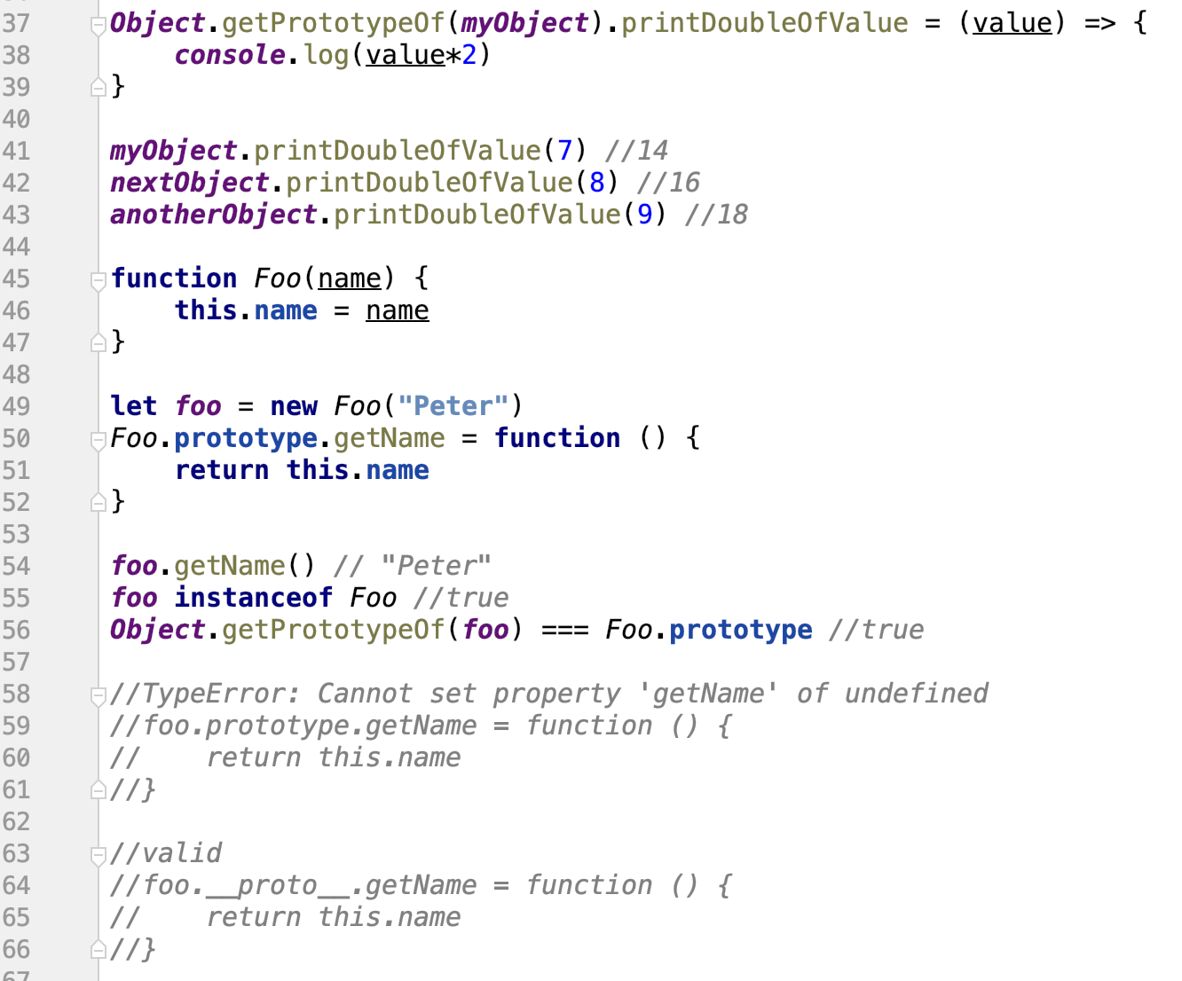
Prototype 2
pamatovat si, že přes prototype jsou implementovaný classy -> tohle nikdo jinak nepoužívá

Slide 49
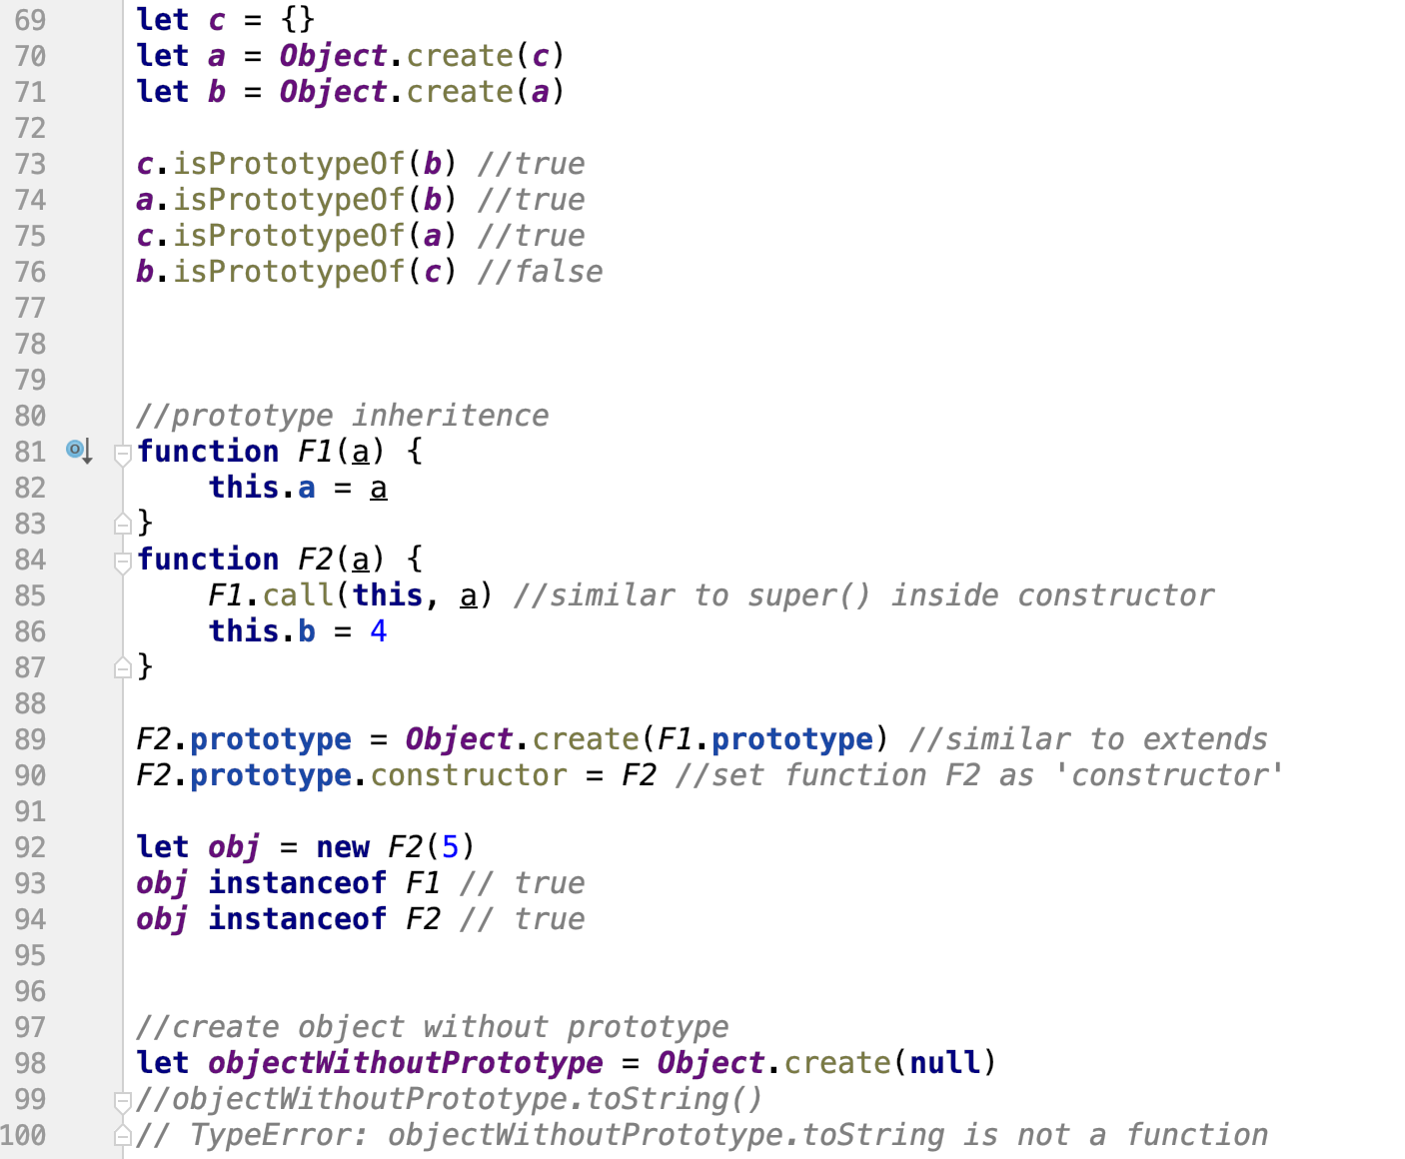
Prototype 3
Notes:
- example of prototype inheritance which is used in classes

Slide 50


Class
podrtžítko se má tvářit jako private, ale nikdo to nezajistí
Notes:
syntax sugar for functions and prototypes
allows to write code in nonJS way
private method starts with underscore (only community convention)

Slide 51

Exercise 5
npm test -- exercise-5.test.js

Slide 52

Exercise 5 - bonus
npm test -- exercise-5-bonus.test.js

Slide 53

ES6 - destructuring
tímhle zápisem si můžeme z objektu vytáhnout parametry, které my chceme, případně pod mojeProm: a si vytáhneme proměnnou a vložíme do mojeProm
přes ...rest hodí zbytek proměnných do novýho objektu

Slide 54


Static types
using transpilation
TypeScript (Microsoft)
programming language
specific syntax
much more features
syntax is much closer to Java
large community
Flow (FaceBook)
static type checker
out of the box utility
slow
crazy version changes
https://codeburst.io/strict-types-typescript-flow-javascript-to-be-or-not-to-be-959d2d20c007
Notes:
- TypeScript increase in popularity

Slide 55

Node.js
it's not server version of JavaScript
it's not framework
Node.js is runtime

Slide 56

Node.js
Google V8 engine
compiler
Executor
C++
Libuv
low level library
async I/O
C
Node-core
hight level library
JavaScript
Node.js Design Patterns by Mario Casciaro
Notes:
- not so important, but good to know, we will access only node-core directly

Slide 57
Node.js vs Browser
Node.js is powerful
Working with files?
Of course
Working with OS processes?
Yes
CLI Interface
Obviously
Direct access to the API OS
Small footprint memory
Browser has limited functionality
Especially for security reasons
Working with files?
Very limited. You do not want the foreign script to scramble through your PC
Working with OS processes?
No. The Worker API allows subcriptions
CLI Interface
No. But Chrome Headless using Puppetteer
Notes:
Node.js is less limited and allows to a lot with small recources

Slide 58
Node.js documentation
versions
LTS 12.14.x
Current 13.x
it is recommended to use LTS
Long Term Support - stable version
Doc: https://nodejs.org/dist/latest-v12.x/docs/api/
Notes:
- Long Time support -> that is what we want to use in production, always

Slide 59
ES6 Node.js and Browsers
Node.js
Implements 97%
Usually first
It also often implements nonstandard features
Browsers
11% (Hello Internet Explorer 11)
97% Chrome
What's the solution?
Polyfills
Transpilation
https://kangax.github.io/compat-table/es6/
Notes:
new features are most of the time implemented in Chrome and Node.js, and after that, also in other browsers

Slide 60




Asynchronicity
node JS narozdíl od Javy vytváří sám více vláken a programátor obslouší jenom callbacky
Notes:
which way seems to be better for you?
remember, that we do not want to block the thread, there is only one by default

Slide 61

Error handling?
it seems simple, but...
try catch chytá takhle jenom volání read file,
je potřeba chybu odchytit až v samotným callbacku (tam kde je ten if)
callback je to co vrací metoda
Notes:
- callback is called after try/catch block, so it wont be able to catch the error

Slide 62

Event Loop
1. submit request to the Event Demultiplexer and specify it handler, which will be invoked when the operation completes
2. when set of I/O operations completes, ED pushes the new events into the EQ
3. Event Loop iterates over the items of the Event Queue
4. Each handler is invoked
5. a) new asynchronous operations might be requested during that
5. b) causing new operations to be inserted in the ED
Notes:
- simulate listed steps, but it is not so important

Slide 63

Event Loop
In what order is A, B and C printed?
pozor! callbacky se nevyhodnocují postupně, ale najednou (vícevláknově), takže co se zrovna dřív vykoná, tak se zrovna vrátí
tohle je ukázka jenom pro představu
Notes:
- example that show us, that order won’t be A,B,C because the they spend different time in Event Demultiplexer

Slide 64



Callback
Callback is a function that returns the result of the called operation
Both functions are sync
A typical example of a synchronous callback
Common function:
Function returning callback result:

Slide 65

Asynchronous Callback
The callback is stored on Event Demultiplexer and Event is pushed to the Event Queue after 1000ms
The callback may and does not necessitate an asynchronous operation, it is always necessary to familiarize yourself with the API of the selected operation

Slide 66

takhle vypadá asynchroní volání s callbacky a reakcemi na ně
callback je ten třetí parametr, kde ve volání se provádí kód, který je vykonán po dokončení metody

Slide 67
Exercise 7
Replace the following code with callbacks so that the values ​​are listed in the correct order

Slide 68

Exercise 8
Replace the following code with callbacks so that addString returns the result and was called in the correct order.

Slide 69

Callback Hell
fuj, takhle ne
Notes:
- that’s how to code would look, if we won’t separate it -> show the solution of previous exercise with separated function instead of nesting the code

Slide 70

Node.js Error First Callback
The Node.js convention is to pass exceptions that occurred during the operation as the first callback parameter.
The readFile method loads asynchronously:
We can arbitrarily process an exception in the callback. But as we know, if we throw it over with throw, try {} catch {} does not work.
v err koukneme, že to doběhlo a kdy tam není, tak v druhým parametru najdeme výsledek volání metody

Slide 71

Error Handling inside Callback
Because Event Loop lives out of scope of our program and exceptions are not caught we have to find another way:
pokud je error v samotný metodě, hodíme u error do callbacku, aby se v místě kde se volá metoda mohlo na to v callbacku reagovat
pokud se podaří, dám do erroru null
nepoužívat try catch, to je jeno pro volání metody, není na errory, které mohly nastat v metodě

Slide 72

Promise
Promise API has been added to JavaScript in ES2015 and is an alternative to callbacks for asynchronous operations
The Promise Object represents the future fulfillment (or end of error) of an asynchronous operation.
místo toho hellu se daj volat promisy - jakmile dojede callback, můžeme reagovat then, nebo catch

Slide 73
Basic Promise API
new Promise(( resolve, reject ) => { /* …* / } )
We create new promises by the constructor
The only parameter is the so-called "executor" function
By calling the resolve function, promise is fulfilled (fulfill)
resolve (value) <- return data from the promise
By calling the reject function, the promise is rejected (reject)
reject (reason) <- reason for rejection (usually error)
promise.then((value) => { /* …* / } )
The function then appends to an existing callback promise that is called with the value argument as soon as the resolve(value)
promise.catch ((value) => { /* …* / } )
The catch function works the same way as then, only calls if internally reject (reason)

Slide 74


v promise je resolve a reject, podle toho si člověk vybere, jeslti se zavolá then, nebo catch....složitý, mkrni na kod, nestíháme :(
Ten timeout simuluje nějakou náročnou ulohu, mohlo by tam bejt rovnou resolve, ale to by pak běželo stejně jak kdyby to bylo synchronně

Slide 75

Example
v then (data) je výsledek z předchozí funkce
Takže zavoláme asynchroně metodu a v then reagujeme na jeji výsledek další voláním, můžeme takhle řetězit

Slide 76
Exercise 10
Rewrite the following code using Promise so that the values ​​are listed in the correct order.

Slide 77
Exercise 11
Replace the following code using promises so that addString returns the result and was called in the correct order.

Slide 78

async / await
async / await is the usual designation of the so-called Async functions that have been added to the specification in ES2017
This is an extension to the Promise API, which greatly simplifies the work with asynchronous operations, makes the code easier to understand and sync syntax
For many, this is the most fundamental change in JavaScript from ES2015
taky vrací promisu
taky vrací promisu
do logu se to díky tomu zapíše, až se volání metody api dokonči
api je taky asynchroní metoda
ekvivalent catche
alternativa - je to stejný, jako kdybychom za api zavolali then

Slide 79
async / await rules
an async function is defined by attaching the async keyword before the function definition (even the arrow function)
The await keyword pauses the execution of the async function and is therefore only used within the async function.
suspending the function does not mean blocking the process
async function always returns Promise, which:
resolves with the return value of the async function
is rejected with an unhandled exception dropped async function
If the async function synchronously returns a value, or throws an exception then its return value is already resolved or rejected by Promise

Slide 80

Example
druhej await se vykoná po vykonání prvního

Slide 81
Exercise 12
Rewrite the following code using async/await so that the values ​​are listed in the correct order.

Slide 82
Exercise 13
Replace the following code using async/await so that addString returns the result and was called in the correct order.

Slide 83
Node.js API
To work with Node.js, it is necessary to know some structures that are commonly used across the ecosystem.
Stream vs Buffer
Path
FS

Slide 84

Events
Node.js is "event driven". What does it mean?
Event = event. In the asynchronous world of Node.js, almost everything under the lid is controlled by broadcasting and listening to events.
Normally, we call this a Observer pattern
Who knows the Publish / Subscribe pattern is something very similar

Slide 85
EventEmitter
The class is available in the "events" module of the standard Node.js library
But that does not have to be of any interest to us because we only need it to implement our own EventEmitters, which we do not need yet.
It is important to learn to work with existing EventEmitters.
The basic feature we will use most often is:
emitter.on ("event", callback);
We do not say anything like this: "Hey, emitter, when you happen event", call this callback. "
Technically, the .on() function registers the listener's emitter for that event.

Slide 86
Buffer vs Stream
Buffer is a simplified data structure that contains binary data
binary not in the sense of nulls and nulls, but usually the so-called "octets" field, which is nothing but 8 bits, so you're
In Node.js, the Buffer class is available as a global variable
For our purposes, it is crucial that if I load the file into the Buffer, it will be fully loaded into my memory
on laptops with 8GB of RAM it does not look like a problem
on cloud servers it's a problem!
In Node.js and other environments and languages, this problem is addressed by using Streams
buffer postupně ukládá nějaká data - nakonec obsahuje celej soubor, se kterým se dá zacházet
stream - vždycky načte jenom kousek a dá ho k dispozici (podstatně menší datová náročnost než buffer)

Slide 87

Buffer diagram

Slide 88
Stream
Stream is not a data structure like Buffer, but an object that allows you to work with binary data
Internally, Buffer contains a number of units up to tens of kB
Stream provides an API for working, reading, and writing data
Readable, Writable, Duplex, Transform, are the classes of the "stream"
For our purposes, we are especially pleased with Readable and Writable streams

Slide 89

Stream diagram

Slide 90
Stream API
Stream is EventEmitter
.on(„data“, (data) => {...})
.on(„readable“)
.on(“end“)
...
For us, the .pipe() method is important:
Where sourceStream is Readable and destinationStream is Writable
na co se dá reagovat ve streamu
přes pipe se daj streamy řetězit

Slide 91

Why use Streams
Notes:
- as you can see, it saves time

Slide 92

Example

Slide 93
Working with files
To work with file system Node.js, there are two useful modules: "fs" and "path".
fs (File System):
Comprehensive library for working with the file system
Allows files and directories not only to read and write (both synchronously and asynchronously), but also to change rights, create links, and more
https://nodejs.org/dist/latest-v10.x/docs/api/fs.html
path
Module containing helper functions for working with paths in the file system
Since Windows and Unix work differently on the paths, we use the path whenever we need to enter any path in the program
https://nodejs.org/dist/latest-v10.x/docs/api/path.html

Slide 94
Reading from files
To read the files, Node.js offers 3 main methods
fs.createReadStream (path)
Creates a readable stream for reading from a file
Until the stream begins to read, nothing happens
From the point of view of the effectiveness of the program, the best solution
fs.readFile (path, callback)
Asynchronously loads the entire file into Buffer (Buffer)
fs.readFileSync (path)
Synchronously loads the entire file into Buffer (Buffer)
that is, is blocking! Until the file is fully loaded, the Node.js process will do nothing else
Only use when starting the application, never running
All methods have optional options
vyrobí stream, ze kterýho se dá číst
načte celej soubor a vrátí v podobě callbacku v bufferu
pokud bychom použili tuhle metodu, tak by se to četlo synchroně a celej program by se zaseknul

Slide 95
Writing to files
We use analog methods to write files
fs.createWriteStream (path)
Creates a Writeable stream for writing to a file
Until someone writes a stream, nothing happens
the best solution
fs.writeFile (path, data, callback)
Asynchronously writes data (string, buffer) to a file
fs.writeFileSync (path, data)
Synchronously writes data (string, buffer) to a file
Again blocking! Only at the start (or end of run) of the application.
All methods also have optional options
zápis ze streamu do souboru

Slide 96
__filename and __dirname
They are "global" variables available in each script
__ are two behind
in fact, it is not a global variable, but a closure scoped variable that Node.js inserts into each module (as well as require () or module)
__filename
Returns the absolute path to the file (module) in which the variable is used
It does not just return the name of the file
__dirname
Returns the absolute path of the directory where the file (module) in which the variable is used
It does not just return the name of the directory
absolutní cesta k souboru

Slide 97
Path
From the path module we will most often use the method
path.join(segment1, segment2, segment3, …)
pro spojení a normalizaci částí cesty
Returns the path to a file that is in the "folder" directory that is two levels higher than the current directory
path.resolve(segment1, segment2, …)
we will use the relative path to obtain the absolute path from the path
Returns the absolute path to a file that is up in the "folder" directory.

Slide 98
Exercise 14
Implement a class that contains methods for saving and loading a book.
API: async createbook (book), async getbook (code)
Each book contains at least the code, name, and author attributes
Books will be saved in json format
The books.json file
Working with json using API: JSON.parse(), JSON.stringify(obj)
Use asynchronous API fs.readFile and fs.writeFile
For ease of use, use the util.promisify library
Error handling - books.json does not exist, bad format.
book code must be unique - check when saving
If a book with an existing code is saved, an exception with the code attribute "DUPLICATE_CODE" is dropped.

Slide 99


NPM
npm is the package manager for JavaScript and the world’s largest software registry.
https://www.npmjs.com/
package.json
npm init
npm install express
npm install jest --save-dev
create start script
node index.js
npm start
obsahuje seznam závislostí
říká, jeslti je to balíček běžící na produkci
Notes:
- lets create new folder and initialize new project in it, install dependency and dev dependency, add start script and execute it

Slide 100

Express.js
https://www.npmjs.com/package/express
https://expressjs.com/en/guide/error-handling.html
Notes:
- explain main things, we care about when we are looking at some module at npmjs

Slide 101

NPM security
Snyk
Use open source. Stay secure.
https://snyk.io/
based on Vulnerability Database
Test you code for free
npm install -g snyk
snyk auth
snyk test
npmjs (available in npm@6)
https://docs.npmjs.com/auditing-package-dependencies-for-security-vulnerabilities
npm install npm@latest -g
npm audit
it runs automatically when you install a package with npm install

Slide 102


Node.js scaling
common concept is to have multiple processes running on the same port with some sort of internal load balancing
Node.js cluster mode
the automatic higher-level PM2 cluster (process manager)
cover the role of the "master" process
do not forget to be stateless
https://cdn-images-1.medium.com/max/1600/1*p6YEK7y6JsVYBaZkhu4UbQ.png
https://cdn-images-1.medium.com/max/1600/1*iSVmpaGmwYzXWydLJnzM3A.png
Notes:
- good to know

Slide 103

Node.js Addons
Addons provide an interface between JS running in Node.js and C/C++ libraries
to integrate a third party library written in C/C++
to rewrite the modules in C++ for performance reasons
written in C++, that can be loaded into Node.js using the require() function, and used just as if they were an ordinary Node.js module
https://nodejs.org/api/addons.html
https://nodeaddons.com
https://static-2.gumroad.com/res/gumroad/8306672884185/asset_previews/df5624ce23c2dcf0a561491a3e1c0dfa/retina/cover.png
Notes:
- good to know, that there is something like this, that allows us to use existing libraries in C/C++

Slide 104


Node and JS weekly
https://nodeweekly.com/
https://javascriptweekly.com/
New features
Tutorials and Options
Code and Tools
Notes:
- how to learn new things in JS/Node.js every week

Slide 105
Exercise 15
Implement an API server to create and load a book
It will work with the storage of the previous task
GET getBook - returns the book by query parameter
POST createBook - Stores a book with parameters sent in request points
Error handling
getBook
Code attribute not assigned (400)
Book with the specified code does not exist (400)
createBook
No attribute code, name or author (400) specified
The book already exists in the database - duplicate code (400)
Unexpected database error (500)
implement caching for books. The cache can contain up to 10 records.
Take advantage of the lru-cache library (https://github.com/isaacs/node-lru-cache)

Slide 106
Notes:
good job

